Slide 1
Consejo Genético en Cáncer de Próstata
Ángel Borque Fernando
Jefe de Sección, Unidad de Próstata, Servicio de Urología (HUMS). – Coordinador Grupo Interdisciplinar ASGECAP

Slide 2
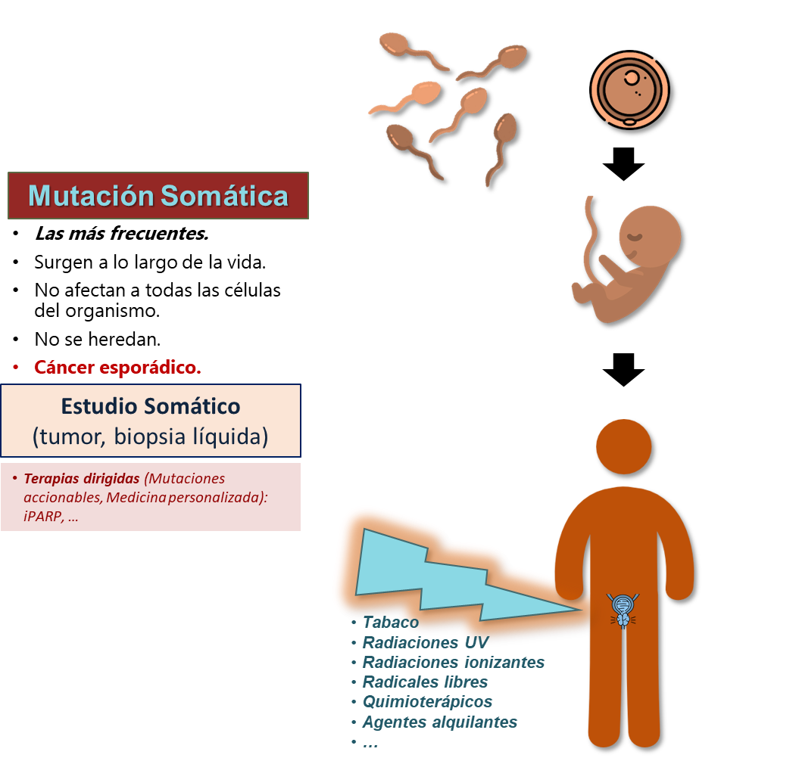
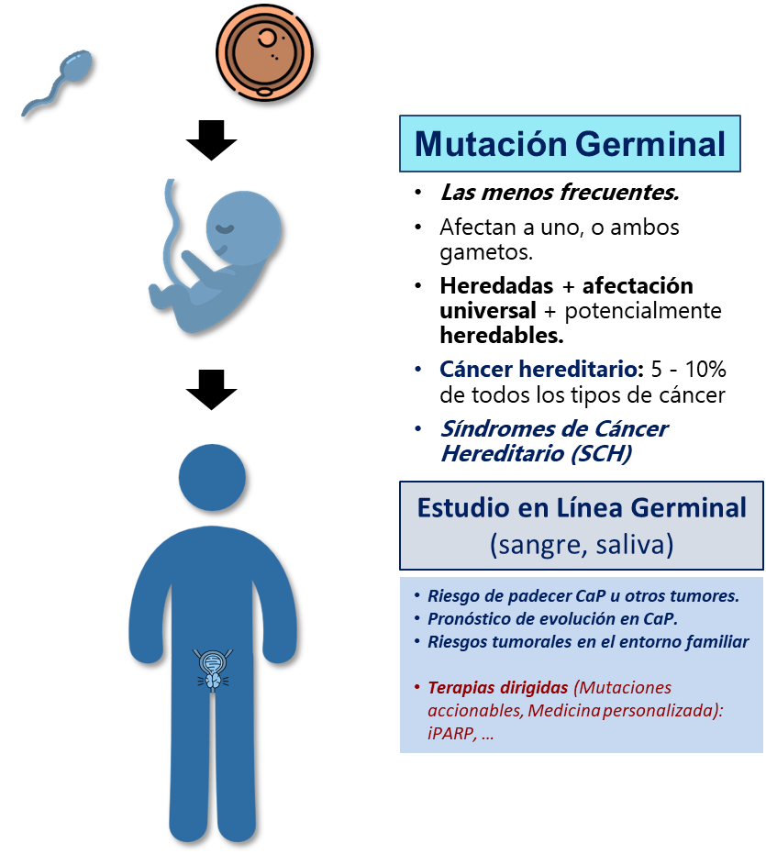
Mutaciones Somáticas, Germinales y Síndromes de Cáncer Hereditario (SCH)
Terapia 1:
Terapia 2:
Terapia 3:
Terapia 4:
Terapia 1:
Terapia 2:
Terapia 3:
Terapia 4:
25%
25%
25%
25%
Infografía Ángel Borque (ASGECAP-HUMS).
Modificado de iconos realizados por Blackwoods , Eucalyp, Freepick y Pixel perfect (www.flaticon.com )

Slide 3
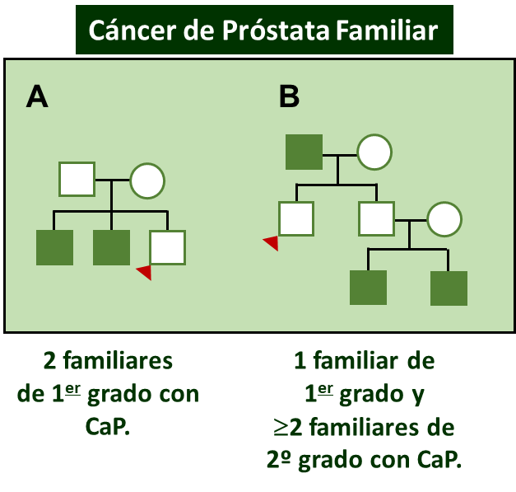
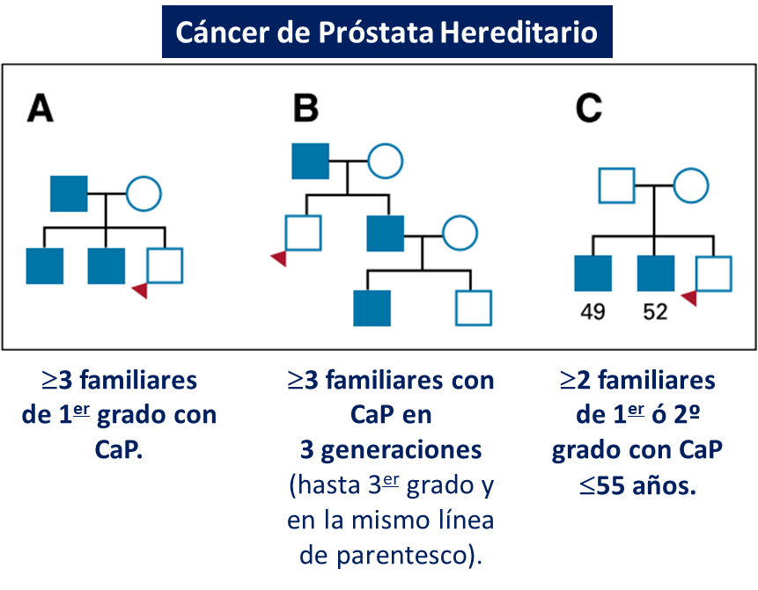

Tipos de Cáncer de Próstata












Cáncer de próstata
FAMILIAR
15 – 20%
Cáncer de próstata
ESPORÁDICO
70 – 80%
Cáncer de próstata
HEREDITARIO
5 – 10%
Nagy R. Oncogene 2004;23:6445-70. / Beebe-Dimmer J. JCO 2020;28:1807-13. / Observatorio Asociación Española contra el Cáncer https://app.powerbi.com/view?r=eyJrIjoiNDVmNjdlOTQtOTE5Zi00YmJmLWJhMjgtNTgxMGJkM2FjYTE3IiwidCI6ImJjYTNjYTJlLTYyNGMtNDNhYS05MTgxLWY2N2YxYzI3OTAyOSIsImMiOjh9
Dr. Ángel Borque Fernando (ASGECAP-HUMS)
Notes:
HUMS: Área asistencial de 386.507 habitantes (47,4% varones).

Slide 4
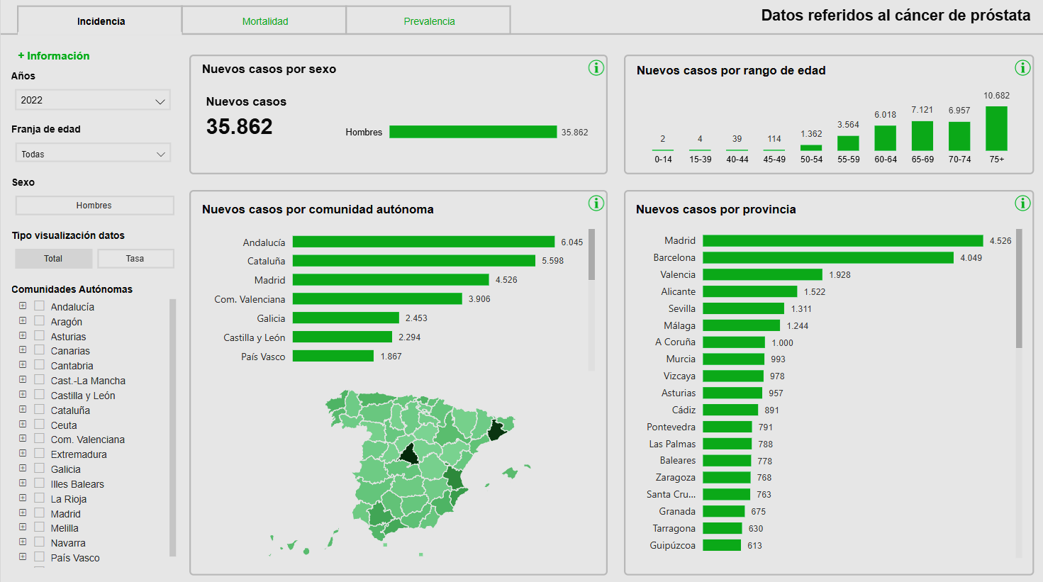
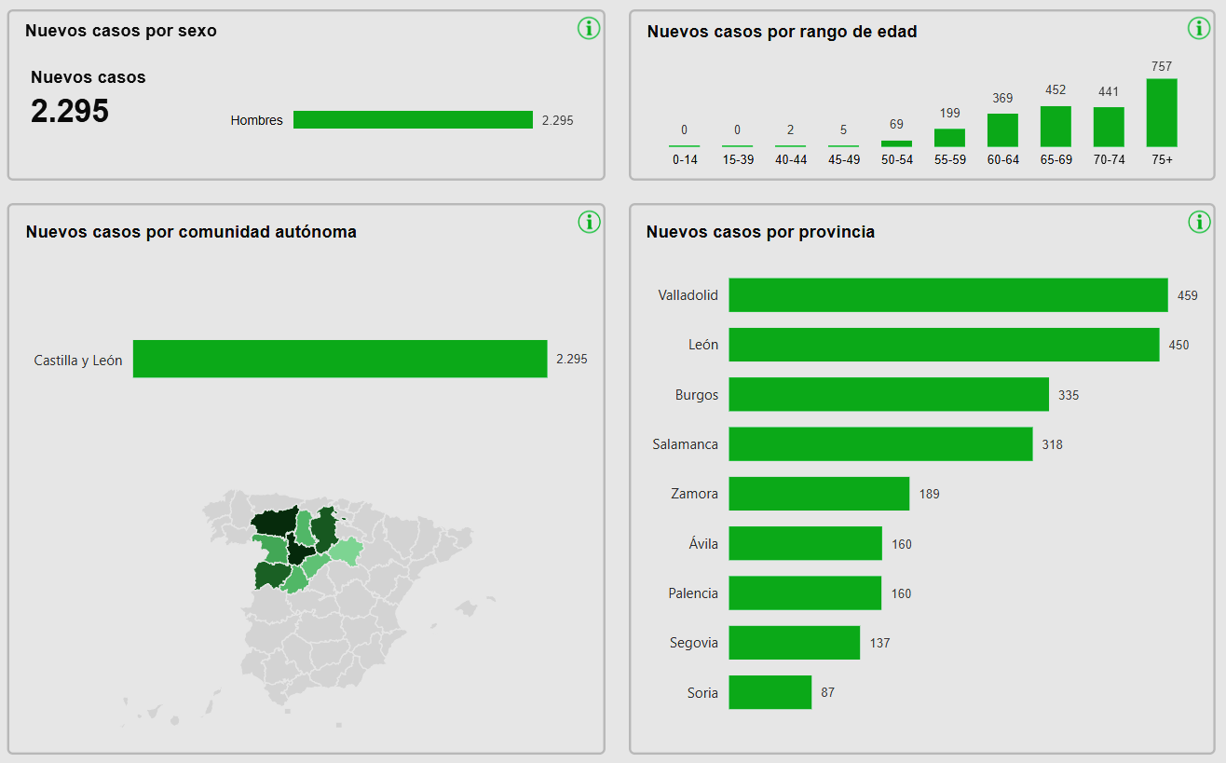
Cáncer Hereditario (5-10%)
3.600 casos en 2022
Cáncer Hereditario (5-10%)
230 casos en 2022
Observatorio de la Asociación Española Contra el Cáncer. https://app.powerbi.com/view?r=eyJrIjoiN2Q4ZWFiZGUtMTk4Mi00Y2RlLWFkOTMtMTNmOTYxZGM3ZTYyIiwidCI6ImJjYTNjYTJlLTYyNGMtNDNhYS05MTgxLWY2N2YxYzI3OTAyOSIsImMiOjh9

Slide 5
5
Dr. Ángel Borque Fernando (ASGECAP-HUMS)

Slide 6
Los síndromes de cáncer hereditario (SCH) en nuestro entorno:
Cáncer de Mama/Ovario Hereditario
Ginecología – Cirugía General
Cáncer de Colon – Sínd. de Lynch
Digestivo – Cirugía General
Otros cánceres
Endocrinología – Oncología Médica – Atención Primaria
Cáncer de Próstata
Urología – Oncología Radioterápica
Consulta Cáncer Hereditario
Genética – Oncología Médica
Dr. Ángel Borque Fernando (ASGECAP-HUMS)

Slide 7
El cáncer de próstata hereditario
es una realidad presente
y ligada a otros síndromes de cáncer hereditario
Dr. Ángel Borque Fernando (ASGECAP-HUMS)

Slide 8
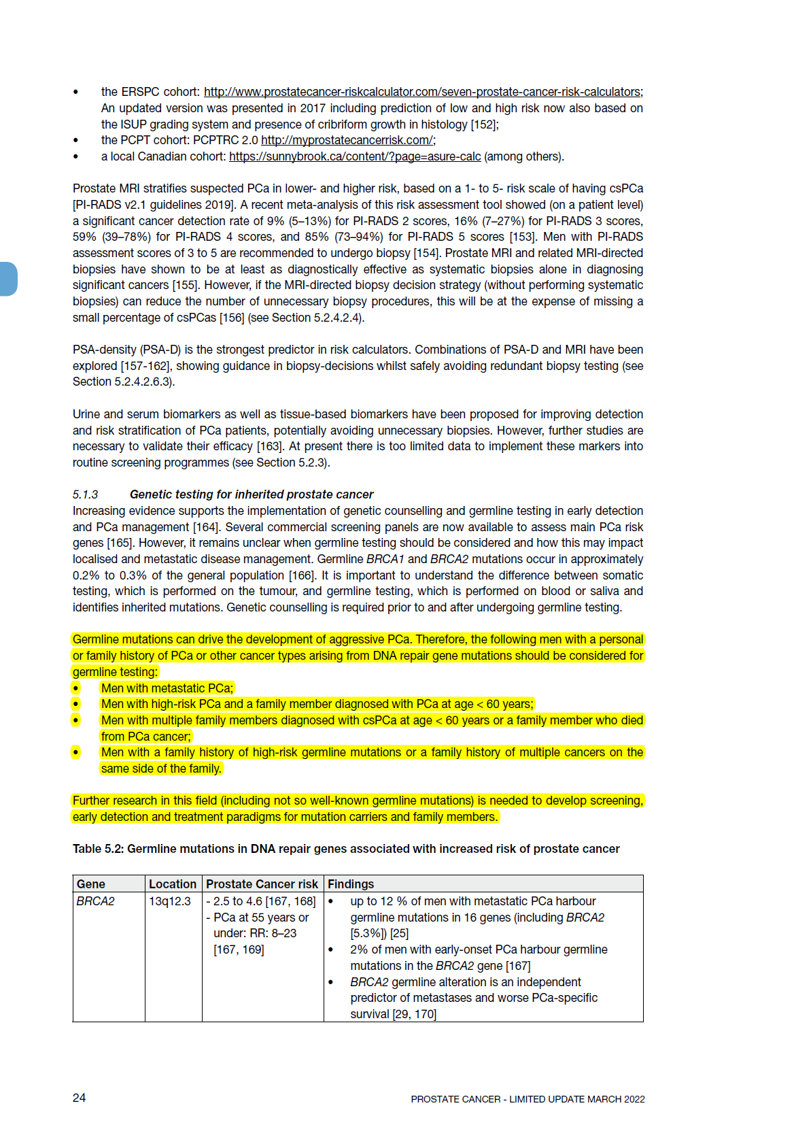
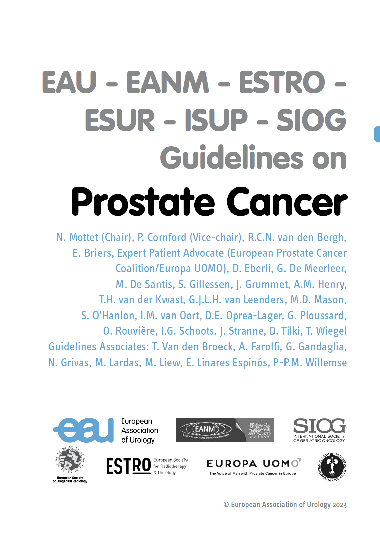
8
¿A qué nos obligan las GUÍAS DE PRÁCTICA CLÍNICA?
5.1.4 Guías para el estudio en línea germinal *
Recomendaciones | Grado de fortaleza
Considere estudio germinal en hombres con CaP metastásico. | débil
Considere estudio germinal en hombres con CaP de alto riesgo que tengan un familiar diagnosticado con CaP a la edad <60 años. | débil
Considere estudio germinal en hombres con varios miembros de la familia diagnosticados con CaP a la edad de <60 años o un miembro de la familia que falleció por CaP. | débil
Considere estudio germinal en hombres con antecedentes familiares de mutaciones de la línea germinal de alto riesgo o antecedentes familiares de múltiples cánceres en el mismo lado de la familia. | débil
* Se requiere asesoramiento genético antes del estudio germinal.
Dr. Ángel Borque Fernando (ASGECAP-HUMS)

Slide 9
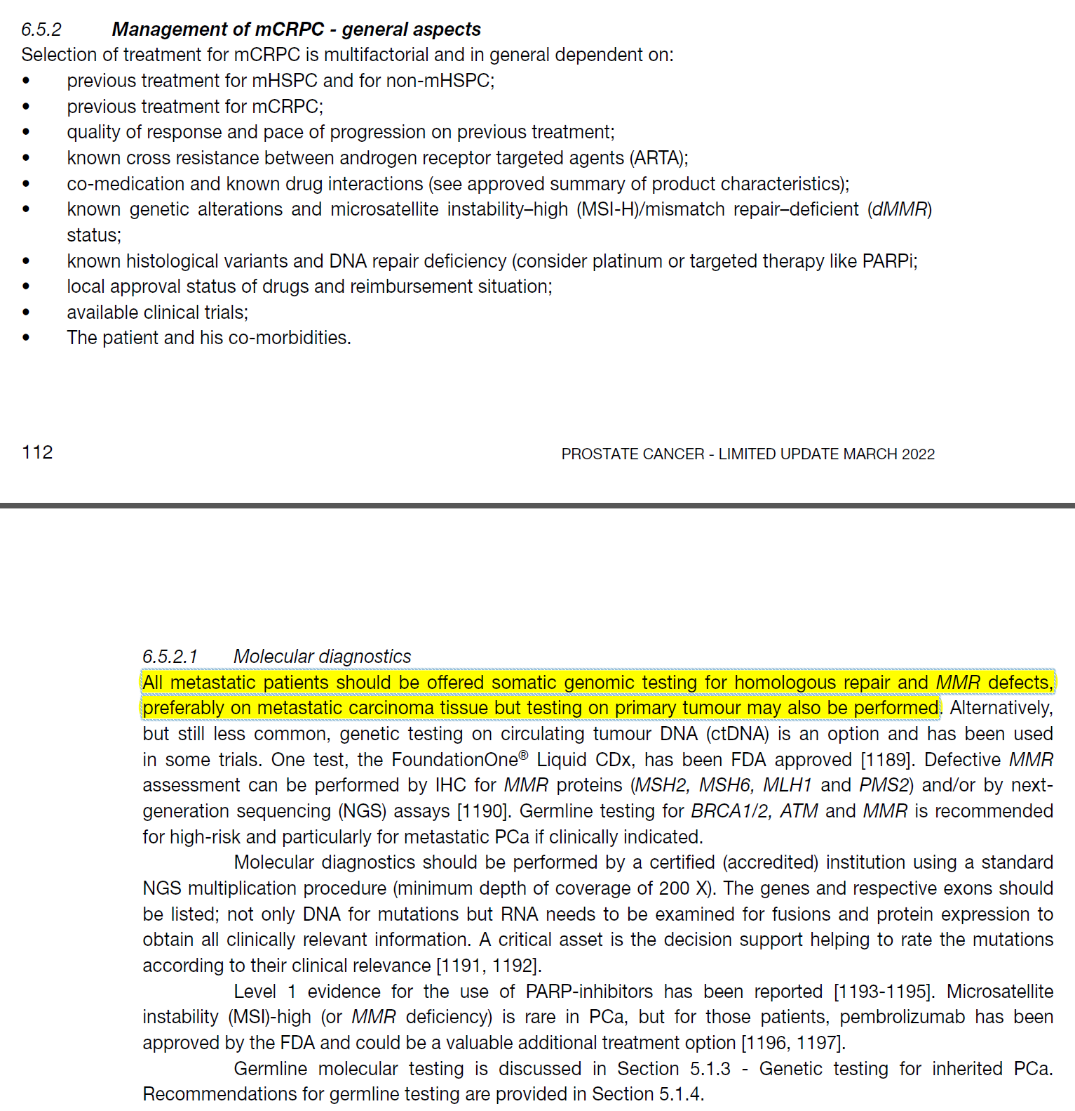
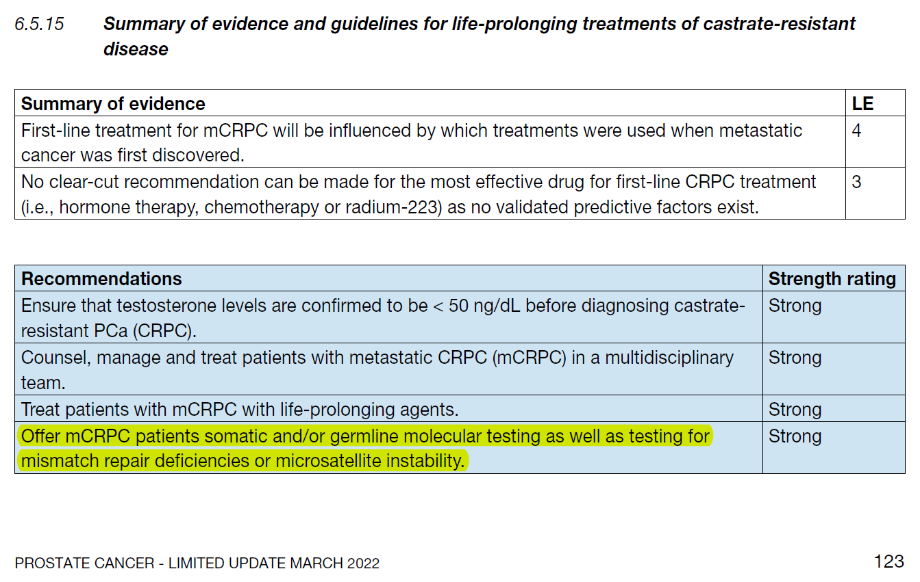
9
¿A qué nos obligan las GUÍAS DE PRÁCTICA CLÍNICA?
Ofrecer a pacientes CPRCm estudio somático y/o germinal así como estudio de alteraciones en mal-apareamiento o inestabilidad de microsatélites | Fuerte

Slide 10
10
¿A qué nos obligan las GUÍAS DE PRÁCTICA CLÍNICA?
96%
4%
NCCN Clinical Practice Guidelines in Oncology (NCCN Guidelines®) for Prostate Cancer V.1.2023
Modificado de: Cózar JM et al. BJU Int 2012;110:E701-E706
Dr. Ángel Borque Fernando (ASGECAP-HUMS)

Slide 11
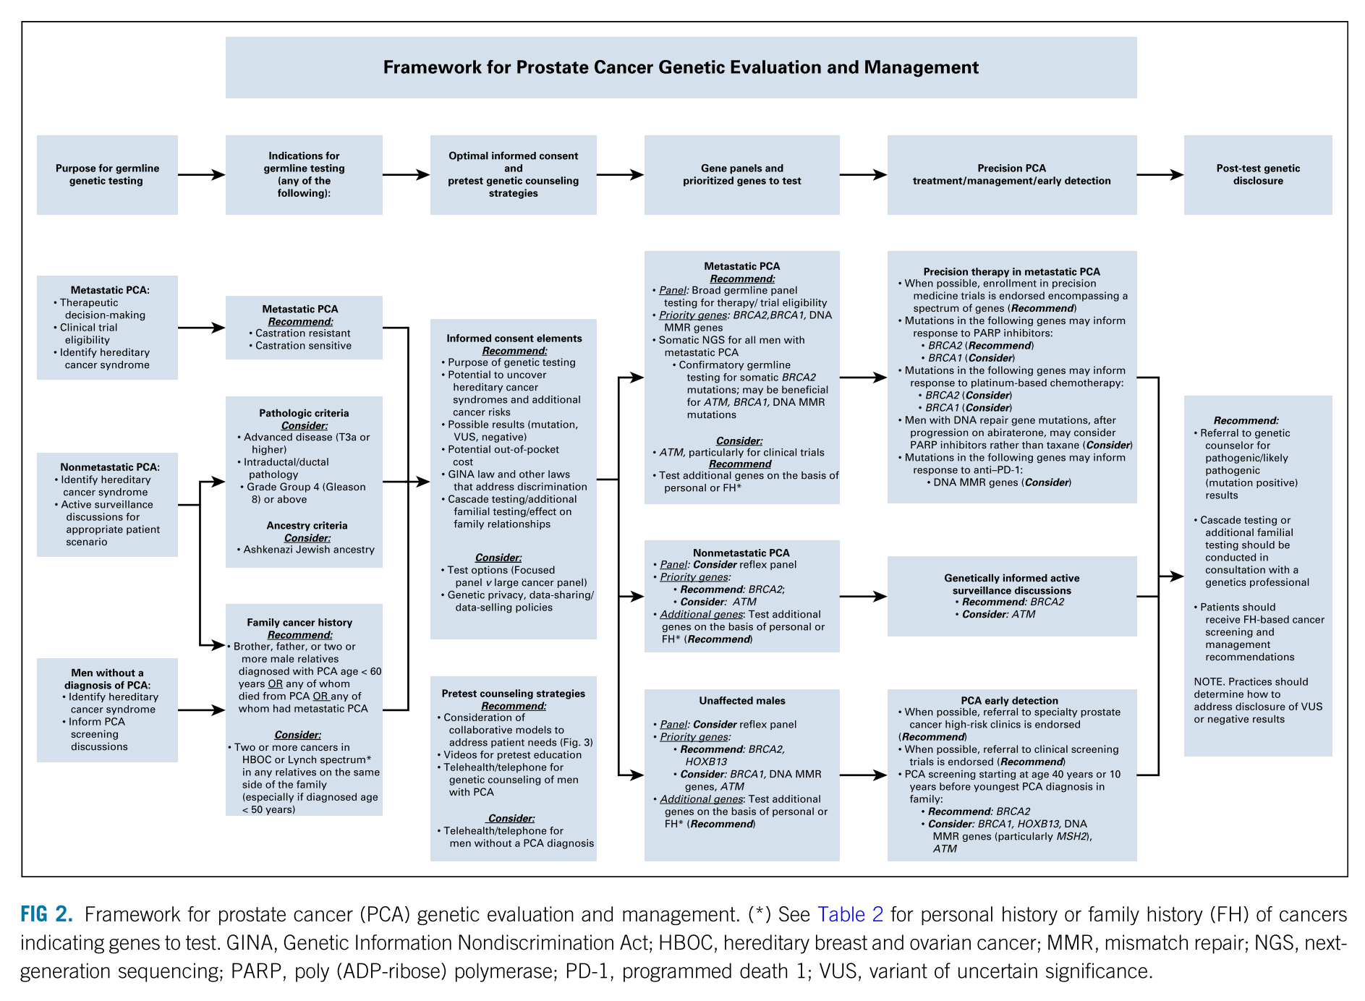
Consenso Philadelphia 2019
Dr. Ángel Borque Fernando (ASGECAP-HUMS)
Giri VN. Consenso Philadelphia-2019. JCO 2020

Slide 12
El cáncer de próstata hereditario
es una realidad presente
y ligada a otros síndromes de cáncer hereditario
Las Guías de Practica Clínica y Consensos de Expertos
nos obligan a la implementación
del Estudio Genético en Cáncer de Próstata
Dr. Ángel Borque Fernando (ASGECAP-HUMS)

Slide 13
Varones sin CaP conocido
Pacientes con CaP en Vigilancia Activa
Aplicabilidad clínica de las alteraciones genéticas del cáncer de próstata
Pacientes con CaP Localizado/Localmente Avanzado
Pacientes con CaP Metastásico

Slide 14
Varones sin CaP conocido
Aplicabilidad clínica de las alteraciones genéticas del cáncer de próstata
Dr. Ángel Borque Fernando (ASGECAP-HUMS)

Slide 15
Familiares sin CaP, candidatos a ASGECAP (gBRCA y gMMR), Estudio IMPACT:
2932 varones, 40-69 años, Historia familiar de CaP y antecedentes familiares de mutación gBRCA1/2.
902 (30%) gBRCA2 (+) / 497 (16%) gBRCA2 (-)
Seguimiento 3 años. BxP si PSA > 3 ng/mL.
828 varones, 40-69 años, Historia familiar de CaP (186 casos) y antecedentes familiares de mutación gMMR.
204 (25%) gMLH1 (+) / 65 (9%) gMLH1 (-) / 305 (37%) gMSH2 (+) / 76 (9%) gMSH2 (-) / 135 (16%) gMSH6 (+) / 43 (5%) gMSH6 (-) = 644 (78%) gMMR (+) / 184 (22%) gMMR (-) + 134 gBRCA1/2 (-)
Seguimiento 3 años. BxP si PSA > 3 ng/mL.
Incidencia de CaPcs
p = 0,011
77%
40%
gBRCA2 (+)
gBRCA2 (-)
p = 0,019
73%
37%
IMPACT. Page EC. Eur Urol 2019;76:831-42
Adaptado de IMPACT. Bancroft EK. Lancet Oncol 2021;22:1618-31
Notes:
IMPACT study (Identification of Men with a genetic predisposition to ProstAte Cancer: Targeted screening in men at higher genetic risk and controls)

Slide 16
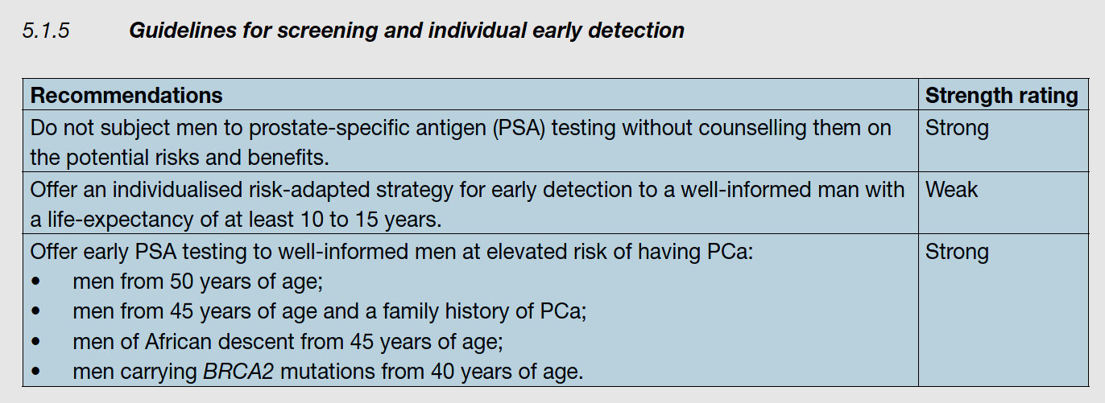
EAU EANM ESTRO ESUR ISUP SIOG Guidelines on Prostate Cancer 2023

Slide 17
NCCN Guidelines v.1.2023 Prostate Cancer Early Detection 2023

Slide 18
Varones sin CaP conocido
Pacientes con CaP en Vigilancia Activa
Aplicabilidad clínica de las alteraciones genéticas del cáncer de próstata
Pacientes con CaP Localizado/Localmente Avanzado

Slide 19
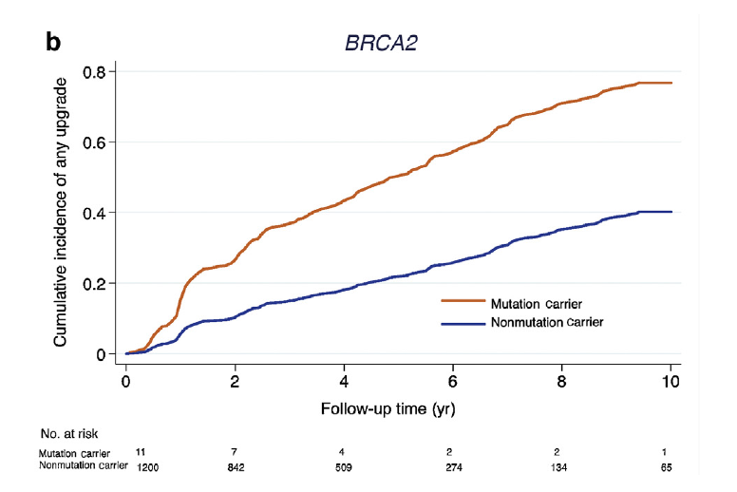
ASGECAP y VA:
Recently, a multidisciplinary consensus conference on germline testing attempted to develop a genetic implementation framework for the management of PCa¹. Based on consensus, BRCA2-gene testing was recommended for AS discussions and could be performed in men with family history of prostate, breast or ovarian cancers. However, the nature of such discussions and how a positive result influences management were beyond the scope of the project. Currently, BRCA2 mutation does not exclude a patient from AS if tumour factors are otherwise favourable. Furthermore, if included in AS programmes, patients with a known BRCA2 mutation should be cautiously monitored until such time that more robust data are available.
¹Giri VN. Philadelphia Prostate Cancer Consensus Conference 2019. JCO 2020;38:2798.
Progresión en Grado en Re-Bx en VA,
según sean portadores gBRCA2
N= 1211 pacs, 289 (23,9%) progresión en grado. Mediana de seguimiento, 3 años (rango 1-6 años)
26 (2,1%) portadores de mutación gBRCA1/2 y/o ATM → 11 (0,9%) portadores de mutación gBRCA2
Progresión en Grado en Re-Bx (VA)
70%
HR = 2,74 (95% CI = 1,26–5,96; p = 0,01)
50%
EAU EANM ESTRO ESUR ISUP SIOG Guidelines on Prostate Cancer 2023
40%
22%
The panel recognizes that there is heterogeneity across the low-risk group, and that some factors may be associated with an increased probability of near-term grade reclassification, including high PSA density, a high number of positive cores (eg, ≥3), high genomic risk (from tissue-based molecular tumor analysis), and/or a known BRCA2 germline mutation. In some of these cases, upfront treatment with radical prostatectomy or prostate RT may be preferred based on shared decision-making with the patient.
22%
10%
Progresión en Grado:
6/11 (54,5%)
278/1185 (23,6%)
Carter HB. Eur Urol 2019; 75: 743-9
NCCN Guidelines v.1.2023 Prostate Cancer 2023

Slide 20
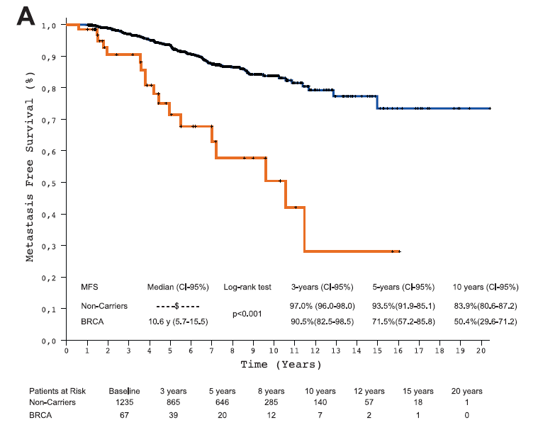
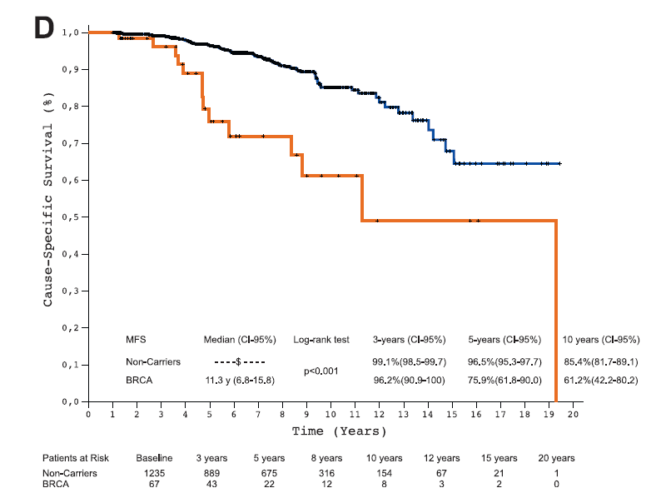
CaP localizado/localmente avanzado:
1.302 pacs. (535 PR + 767 EBRT) CaP localizado/localmente avanzado. Mediana de seguimiento, 64 meses.
67 mutaciones gBRCA2 (5,1%): 35 en PR + 32 en EBRT
SLM (Cirugía y Radioterapia)
SCE (Cirugía y Radioterapia)
97%
99%
94%
97%
84%
96%
85%
90%
72%
Non carrier
Carrier
76%
Non carrier
Carrier
61%
50%
HR = 2,36 (95% CI = 1,38–4,03; p = 0,002)
HR = 2,17 (95% CI = 1,16–4,07; p = 0,016)
Castro E. Eur Urol 2015; 68: 186-93

Slide 21
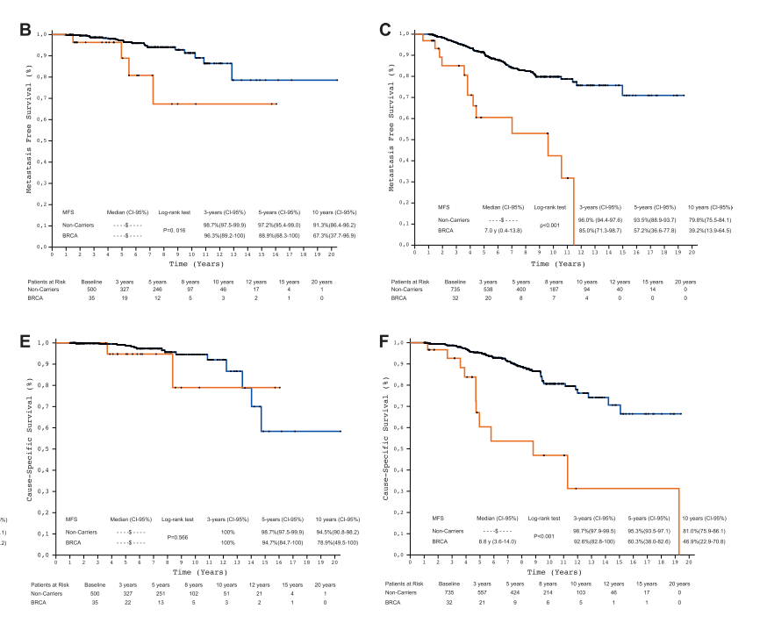
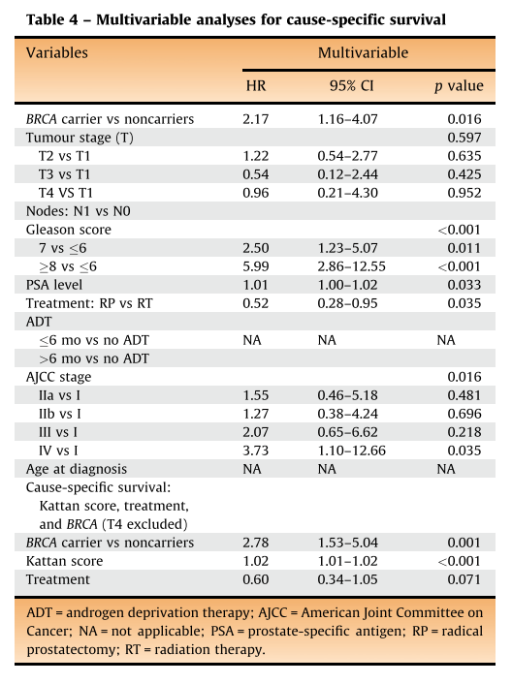
ASGECAP y CaP localizado:
1.302 pacs. (535 PR + 767 EBRT) CaP localizado/localmente avanzado. Mediana de seguimiento, 64 meses.
67 mutaciones gBRCA2 (5,1%): 35 en PR + 32 en EBRT
Supervivencia Libre de Metástasis y Cáncer Específica tras Cirugía/Radioterapia, según sean portadores gBRCA1/2
Radioterapia
SLM
Series retrospectivas
Características no balanceadas:
Prostatectomía vs Radioterapia
Gleason ≥ 8: 26 % vs 44 %
PSA (mediana): 6,0 ng/mL vs 19,4 ng/mL
Alto Riesgo: 34 % vs 69 %
N1: 3 % vs 9 %
Cirugía
Non carrier
Carrier
Radioterapia
SCE
Cirugía
Castro E. Eur Urol 2015; 68: 186-93
Notes:
Fig. 1 – Cumulative incidence of upgrading on biopsies after the
diagnostic biopsy in (A) carriers and noncarriers of mutations in BRCA1/
2 and/or ATM; (B) carriers and noncarriers of mutations in BRCA2 only.
Cumulative incidence based on competing risk analysis. Upgrading
refers to any grade group (GG) or Gleason score higher than diagnostic
biopsy GG irrespective of initial grade at biopsy.

Slide 22
Varones sin CaP conocido
Pacientes con CaP en Vigilancia Activa
Aplicabilidad clínica de las alteraciones genéticas del cáncer de próstata
Pacientes con CaP Localizado/Localmente Avanzado
Pacientes con CaP Metastásico

Slide 23
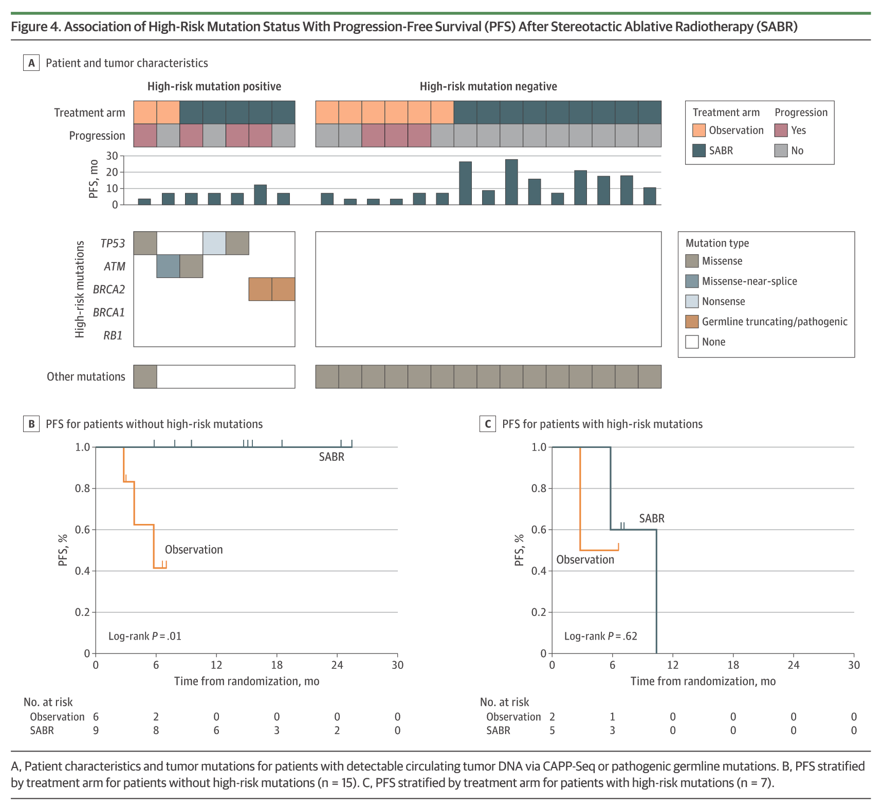
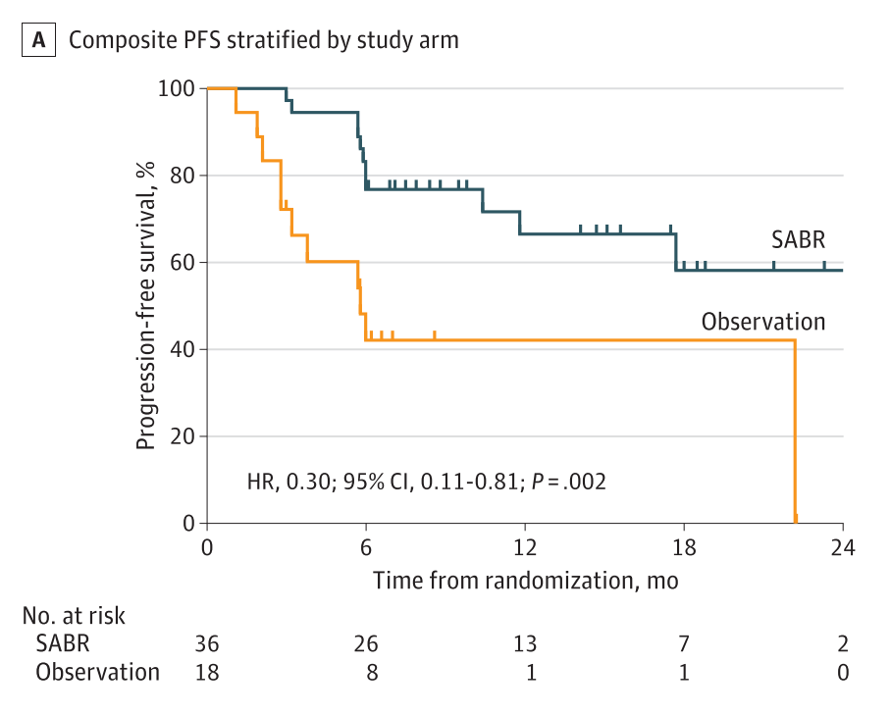
ASGECAP y CaP avanzado, Oligometastásico:
Supervivencia Libre de Progresión tras SBRT en CaP Oligometastásico, según sean portadores gTP53 – gATM – gBRCA2
The ORIOLE Phase II, RCT
22 pacs. CaP Oligometastásico. Mediana seguimiento, 18,8 meses.
7 mutaciones Alto Riesgo: 3 sTP53 – 2 sATM – 2 gBRCA2
15 otras mutaciones Bajo Riesgo
The ORIOLE Phase II, RCT. Phillips R. JAMA Oncol 2020;6:650-9
Notes:
Based on prior sequencing studies that identified mutations associated with outcomes in metastatic prostate cancer, we defined a high-risk mutation signature with truncating/ pathogenic germline mutations identified via a Color Genomics assay and confirmed by CAPP-Seq (Figure 4A; eTables 5 and6 in Supplement 2). To avoid false negatives owing to undetectable ctDNA, we limited our analyses to participants with detectable ctDNA or truncating/pathogenic germline mutations in high-risk genes (n = 22). PFS was significantly longer among participants receiving SABR than among those in the observation arm in the high-risk mutation–negative subgroup (Figure 4B) but not in the high-risk mutation–positive sub- group (Figure 4C).
IMPORTANCE Complete metastatic ablation of oligometastatic prostate cancer may provide an alternative to early initiation of androgen deprivation therapy (ADT).
OBJECTIVE To determine if stereotactic ablative radiotherapy (SABR) improves oncologic outcomes in men with oligometastatic prostate cancer.
DESIGN, SETTING, AND PARTICIPANTS The Observation vs Stereotactic Ablative Radiation for Oligometastatic Prostate Cancer (ORIOLE) phase 2 randomized study accrued participants from 3 US radiation treatment facilities affiliated with a university hospital from May 2016 to March 2018 with a data cutoff date of May 20, 2019, for analysis. Of80 men screened, 54 men with recurrent hormone-sensitive prostate cancer and 1 to 3metastases detectable by conventional imaging who had not received ADT within 6 months of enrollment or 3 or more years total were randomized. INTERVENTIONS Patients were randomized in a 2:1 ratio to receive SABR or observation.
MAIN OUTCOMES AND MEASURES The primary outcomewas progression at 6 months by prostate-specific antigen level increase, progression detected by conventional imaging, symptomatic progression, ADT initiation for any reason, or death. Predefined secondary outcomes were toxic effects of SABR, local control at 6 months with SABR, progression-free survival, Brief Pain Inventory (Short Form)–measured quality of life, and concordance between conventional imaging and prostate-specific membrane antigen (PSMA)–targeted positron emission tomography in the identification of metastatic disease.
RESULTS In the 54 men randomized, the median (range) age was 68 (61-70) years for patients allocated to SABR and 68 (64-76) years for those allocated to observation. Progression at 6 months occurred in 7 of 36 patients (19%) receiving SABR and 11 of 18 patients (61%) undergoing observation (P = .005). Treatment with SABR improved median progression-free survival (not reached vs 5.8 months; hazard ratio, 0.30; 95% CI, 0.11-0.81; P = .002). Total consolidation of PSMA radiotracer-avid disease decreased the risk of new lesions at 6 months (16%vs 63%; P = .006). No toxic effects of grade 3 or greater were observed. T-cell receptor sequencing identified significant increased clonotypic expansion following SABR and correlation between baseline clonality and progression with SABR only (0.082085 vs 0.026051; P = .03).
CONCLUSIONS AND RELEVANCE Treatment with SABR for oligometastatic prostate cancer improved outcomes and was enhanced by total consolidation of disease identified by PSMA-targeted positron emission tomography. SABR induced a systemic immune response, and baseline immune phenotype and tumor mutation status may predict the benefit from SABR. These results underline the importance of prospective randomized investigation of the oligometastatic state with integrated imaging and biological correlates.

Slide 24
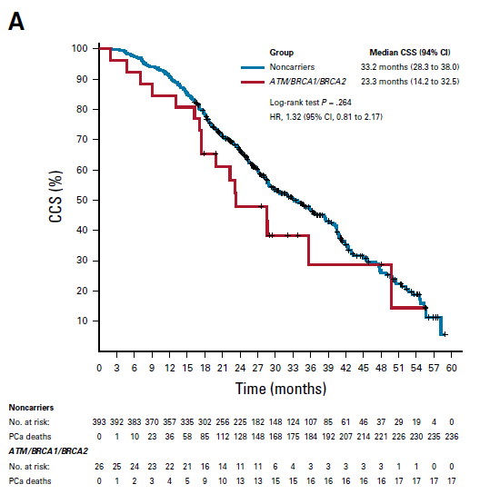
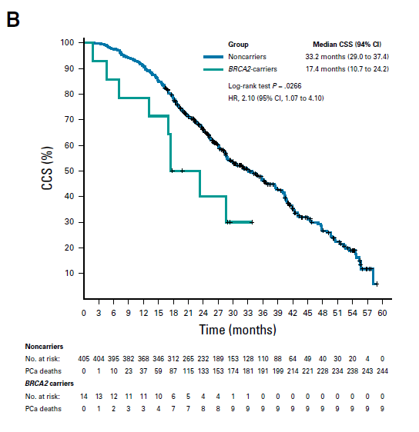
ASGECAP y CaP avanzado, CPRC:
419 pacs. CPRCm. Mediana de seguimiento, 64 meses.
68 mutaciones HR (16,2%): 14 BRCA2 – 8 ATM – 4 BRCA1 – 68 gDDR+
Supervivencia Cáncer Específica en CPRCm, según sean portadores BRCA1/2 - ATM
BRCA1/2 - ATM
BRCA2
33 m.
33 m.
23 m.
17 m.
PROREPAIR-B. Castro E. JCO 2019; 37: 490-503
Notes:
FIG 3. Cause-specific survival (CSS) from diagnosis of metastatic castration-resistant prostate cancer (mCRPC). Kaplan-Meier curves for CSS: (A) ATM/ BRCA1/BRCA2/PALB2versus noncarriers; (B) BRCA2versus noncarriers; (C) All germline DNA damage repair positive (gDDR+) versus noncarriers. (D) Forest plot of univariable hazard ratios (HRs) for CSS. ALP, alkaline phosphatase; ECOG, Eastern Cooperative Oncology Group; LDH, lactate de- hydrogenase; PCa, prostate cancer; PSA, prostate-specific antigen

Slide 25
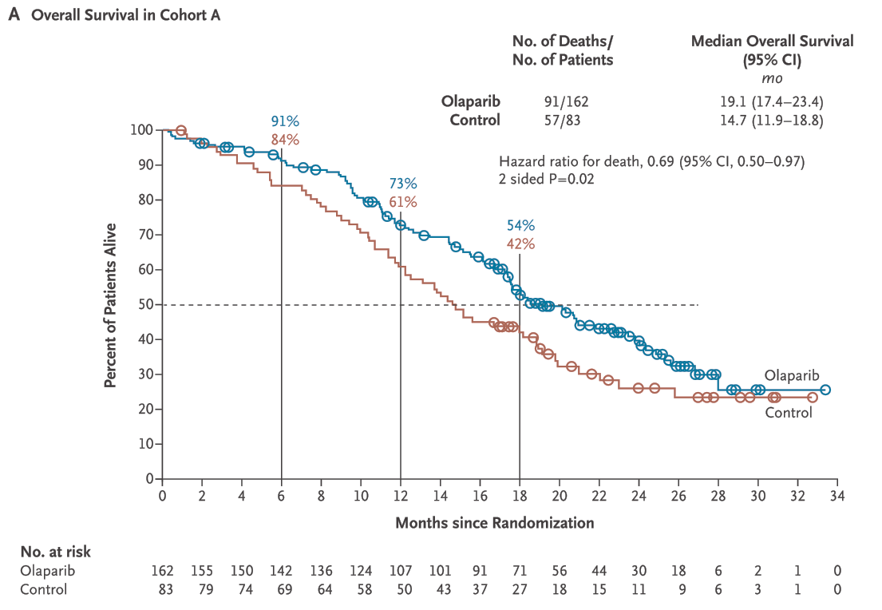
CPRCm, predicción de respuesta a iPARP (BRCA1/2 – ATM; 2ª L.):
CPRCm, predicción de respuesta a Quimioterapia basada en platino (gDDR):
9,2 m.
(5,5-19)
14 m. (5,7-34)
p = 0,20
Estudio PROfound. Hussain M. NEJM 2020;383:2345-57
Schmid S. JAMA Network Open, 2020
Notes:
Figure 1. Kaplan–Meier Estimates of Overall Survival and Corresponding Crossover-Adjusted Sensitivity Analyses in Cohort A.
Panel A shows overall survival among the patients in the intention-to-treat population who had at least one altera- tion in BRCA1, BRCA2, or ATM (cohort A). Panel B shows overall survival in cohort A, as adjusted with the use of a rank-preserving structural failure time model (with a recensoring approach to avoid possible informative censoring bias) to show the effect of crossover of patients from control therapy to olaparib as a subsequent anticancer thera- py. For the patients who had censored data, the median duration of follow-up was 21.9 months among those in the olaparib group and 21.0 months among those in the control group. The alpha spent at the final analysis of overall survival was 0.047. Among the 83 patients in cohort A who were assigned to the control group, 56 (67%) crossed over to receive olaparib.
PLATINO

Slide 26
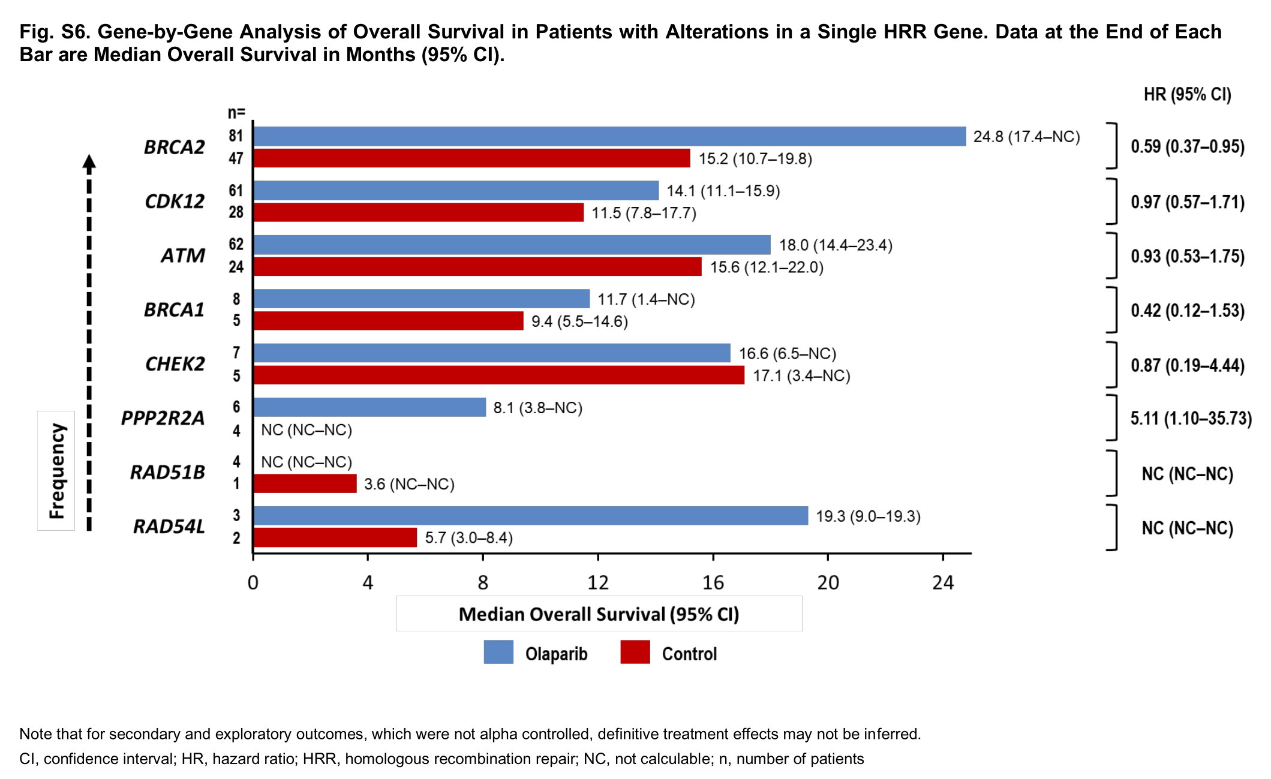
Olaparib for Metastatic Castration-Resistant Prostate Cancer
Estudio PROfound. Hussain M. NEJM 2020;383:2345-57 (suppl. mat.)
Notes:
*

Slide 27
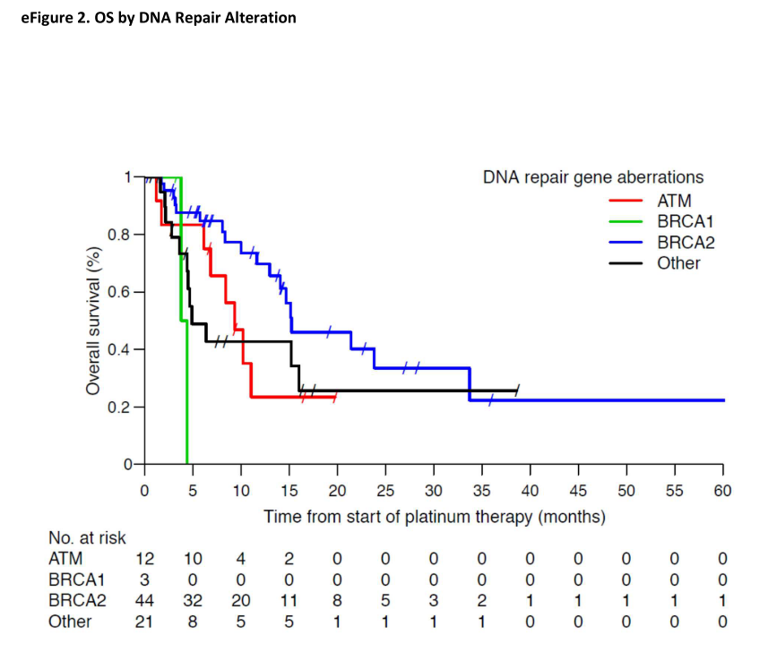
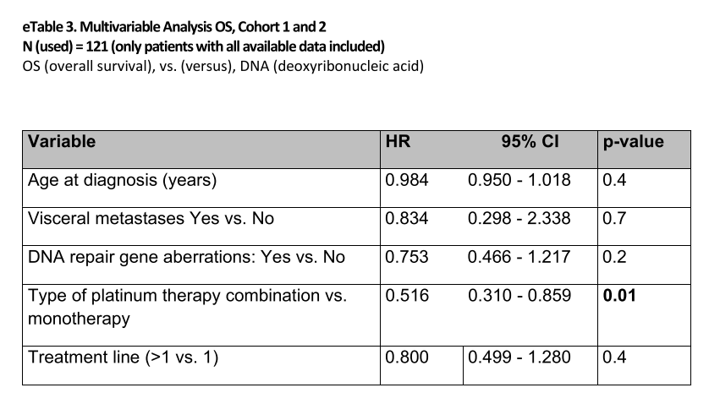
Schmid S. JAMA Network Open, 2020
Notes:
Conclusions In this multicenter international case series, platinum-based treatment was associated with promising activity in a biomarker-preselected population of patients with CRPC and DNA repair gene aberrations.
These results need prospective validation, which hopefully will be provided from the currently recruiting trials in molecularly selected prostate cancer populations.
Based on our analysis, platinum-containing therapy should be considered in patients with DNA repair gene aberrations, especially if access to a PARP inhibitor is not available.
IMPORTANCE DNA repair gene aberrations occur in 20% to 30% of patients with castration- resistant prostate cancer (CRPC), and some of these aberrations have been associated with sensitivity to poly(ADP-ribose) polymerase (PARP) inhibition platinum-based treatments. However, previous trials assessing platinum-based treatments in patients with CRPC have mostly included a biomarker-unselected population; therefore, efficacy in these patients is unknown.
OBJECTIVE To characterize the antitumor activity of platinum-based therapies in men with CRPC with or without DNA repair gene alterations.
DESIGN, SETTING, AND PARTICIPANTS In this case series, data from 508 patients with CRPC treated with platinum-based therapy were collected from 25 academic centers from 12 countries worldwide. Patients were grouped by status of DNA repair gene aberrations (ie, cohort 1, present; cohort 2, not detected; and cohort 3, not tested). Data were collected from January 1986 to December 2018. Data analysis was performed in 2019, with data closure in April 2019.
EXPOSURE Treatment with platinum-based compounds either as monotherapy or combination therapy.
MAIN OUT COMES AND MEASURES The primary end points were as follows: (1) antitumor activity of platinum-based therapy, defined as a decrease in prostate-specific antigen (PSA) level of at least 50% and/or radiological soft tissue response in patients with measurable disease and (2) the association of response with the presence or absence of DNA repair gene aberrations.
RESULTS A total of 508 men with a median (range) age of 61 (27-88) years were included in this analysis. DNA repair gene aberrations were present in 80 patients (14.7%; cohort 1), absent in 98 (19.3%; cohort 2), and not tested in 330 (65.0%; cohort 3). Of408 patients who received platinum- based combination therapy, 338 patients (82.8%) received docetaxel, paclitaxel, or etoposide, and 70 (17.2%) received platinum-based combination treatment with another partner. A PSA level decrease of at least 50%was seen in 33 patients (47.1%) in cohort 1 and 26 (36.1%) in cohort 2 (P = .20). In evaluable patients, soft tissue responses were documented in 28 of 58 patients (48.3%) in cohort 1 and 21 of67 (31.3%) in cohort 2 (P = .07). In the subgroup of44 patients with BRCA2 gene alterations, PSA level decreases of at least 50%were documented in 23 patients (63.9%) and soft tissue responses in 17 of 34 patients (50.0%) with evaluable disease. In cohort 3, PSA level decreases of at least 50% and soft tissue responses were documented in 81 of 284 patients (28.5%) and 38 of 185 patients (20.5%) with evaluable disease, respectively.
CONCLUSIONS AND RELEVANCE In this study, platinum-based treatment was associated with relevant antitumor activity in a biomarker-positive population of patients with advanced prostate cancer with DNA repair gene aberrations. The findings of this study suggest that platinum-based treatment may be considered an option for these patients.
Analysis was stratified to 1 of 3 cohorts: germline BRCA variant, BRCA-like, or non-BRCA. The BRCA variant and BRCA-like groups that received combined therapy showed a statistically significant improvement in PFS and improved overall survival, although the difference for overall survival was not significant. (Aurora M. JAMA Network Open, 2020)

Slide 28
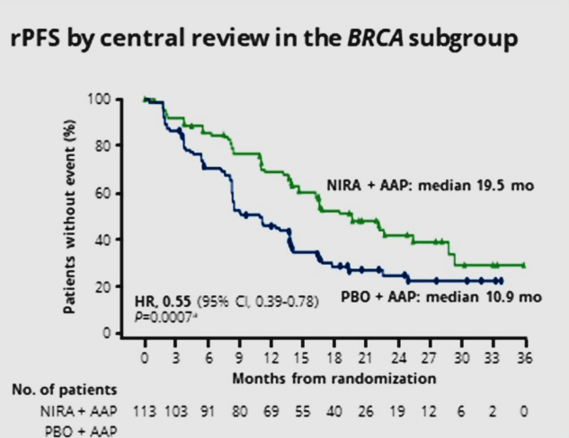
CPRCm, predicción de respuesta a iPARP (BRCA1/2), 1ª L.:
Niraparib + AAP en 1ª L. en CPRCm
Olaparib + AAP en 1ª L. en CPRCm
Prescreening for biomarker status
1:1 randomization
Δ: 8,6 m.
10,9 m.
19,5 m.
Estudio MAGNITUDE. Efstathiou EM. ASCO GU 2023.
Estudio PROPEL. Clarke N. ASCO GU 2023.

Slide 29
PROpel: OS in subgroups (DCO3)

Slide 30
Talazoparib + Enzalutamida en 1ª L. en CPRCm
Agarwal N., et a. Lancet 2023, 4Th June, https://doi.org/10.1016/ S0140-6736(23)01055-3
Notes:
Background Co-inhibition of poly(ADP-ribose) polymerase (PARP) and androgen receptor activity might result in antitumour efficacy irrespective of alterations in DNA damage repair genes involved in homologous recombination repair (HRR). We aimed to compare the efficacy and safety of talazoparib (a PARP inhibitor) plus enzalutamide (an androgen receptor blocker) versus enzalutamide alone in patients with metastatic castration-resistant prostate cancer (mCRPC).
Methods TALAPRO-2 is a randomised, double-blind, phase 3 trial of talazoparib plus enzalutamide versus placebo plus enzalutamide as first-line therapy in men (age ≥18 years [≥20 years in Japan]) with asymptomatic or mildly symptomatic mCRPC receiving ongoing androgen deprivation therapy. Patients were enrolled from 223 hospitals, cancer centres, and medical centres in 26 countries in North America, Europe, Israel, South America, South Africa, and the Asia-Pacific region. Patients were prospectively assessed for HRR gene alterations in tumour tissue and randomly assigned (1:1) to talazoparib 0·5 mg or placebo, plus enzalutamide 160 mg, administered orally once daily. Randomisation was stratified by HRR gene alteration status (deficient vs non-deficient or unknown) and previous treatment with life-prolonging therapy (docetaxel or abiraterone, or both: yes vs no) in the castration-sensitive setting. The sponsor, patients, and investigators were masked to talazoparib or placebo, while enzalutamide was open-label. The primary endpoint was radiographic progression-free survival (rPFS) by blinded independent central review, evaluated in the intention-to-treat population. Safety was evaluated in all patients who received at least one dose of study drug. This study is registered with ClinicalTrials.gov (NCT03395197) and is ongoing.
Findings Between Jan 7, 2019, and Sept 17, 2020, 805 patients were enrolled and randomly assigned (402 to the talazoparib group and 403 to the placebo group). Median follow-up for rPFS was 24·9 months (IQR 21·9–30·2) for the talazoparib group and 24·6 months (14·4–30·2) for the placebo group. At the planned primary analysis, median rPFS was not reached (95% CI 27·5 months–not reached) for talazoparib plus enzalutamide and 21·9 months (16·6–25·1) for placebo plus enzalutamide (hazard ratio 0·63; 95% CI 0·51–0·78; p<0·0001). In the talazoparib group, the most common treatment-emergent adverse events were anaemia, neutropenia, and fatigue; the most common grade 3–4 event was anaemia (185 [46%] of 398 patients), which improved after dose reduction, and only 33 (8%) of 398 patients discontinued talazoparib due to anaemia. Treatment-related deaths occurred in no patients in the talazoparib group and two patients (<1%) in the placebo group.
Interpretation Talazoparib plus enzalutamide resulted in clinically meaningful and statistically significant improvement in rPFS versus standard of care enzalutamide as first-line treatment for patients with mCRPC. Final overall survival data and additional long-term safety follow-up will further clarify the clinical benefit of the treatment combination in patients with and without tumour HRR gene alterations.

Slide 31
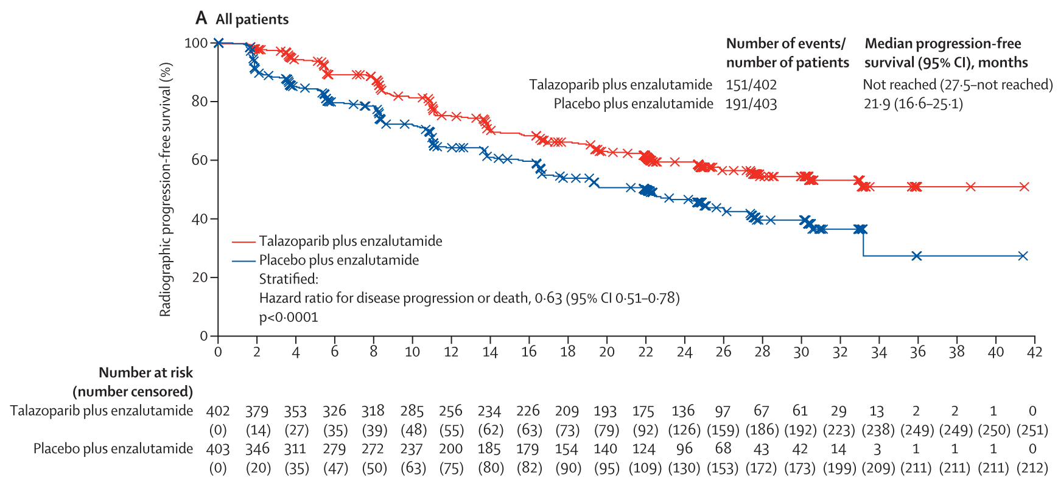
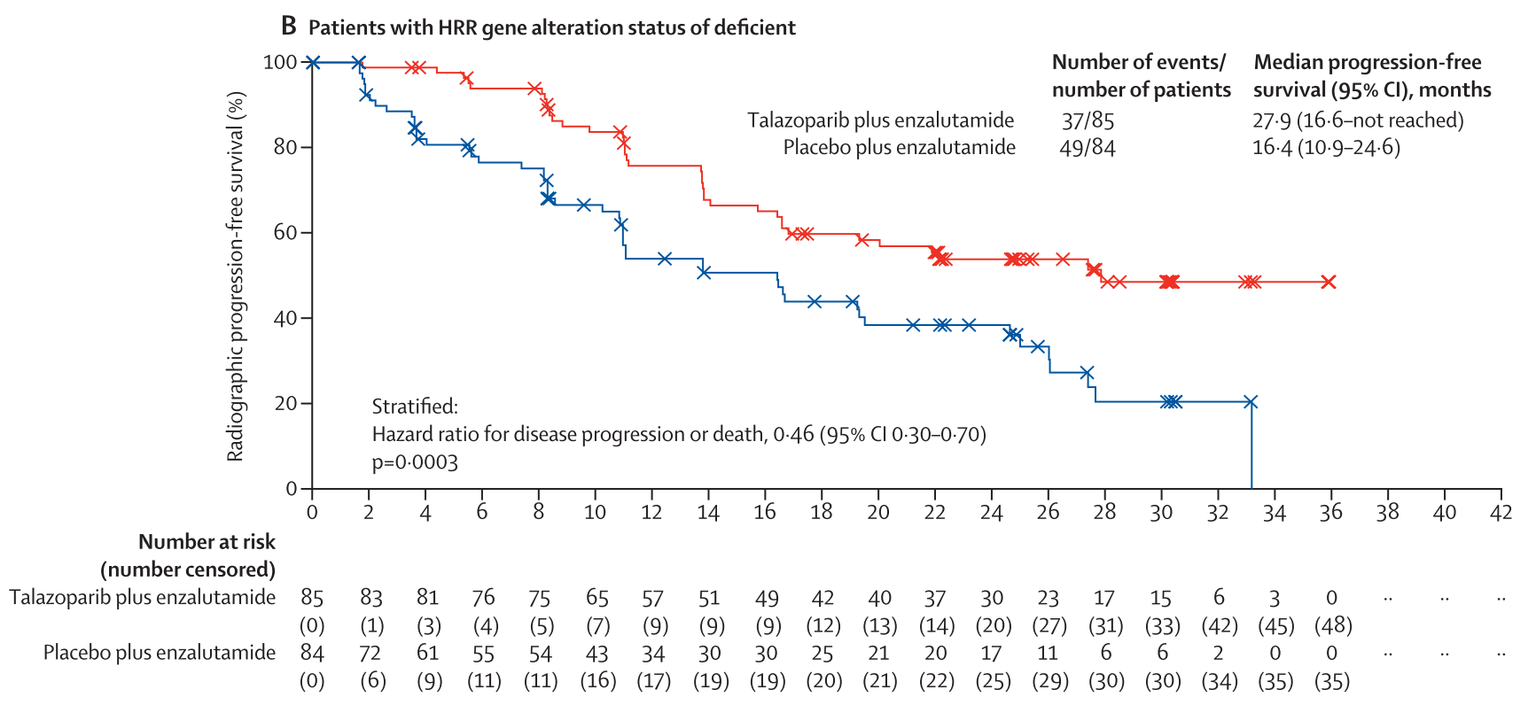
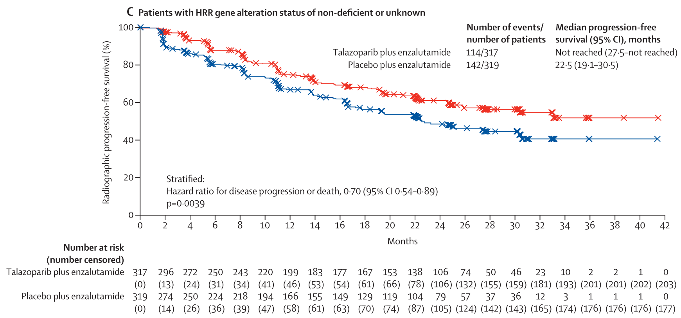
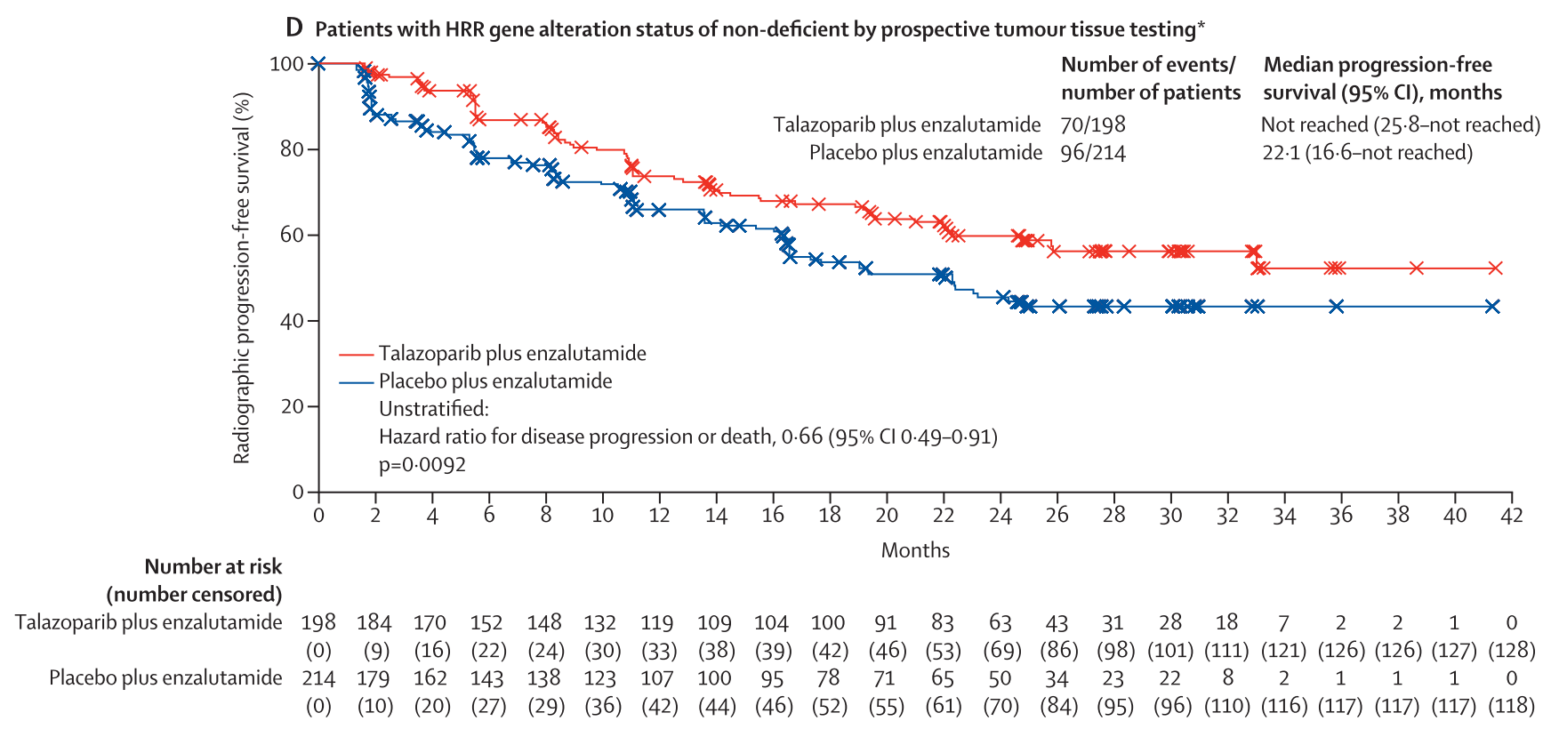
All comers
(402 vs 403)
HRR (+)
(85 vs 85)
HRR (-) o ¿?
(317 vs 319)
HRR (-)
(188 vs 214)
TALAPRO-2, 1ªL. – CPRCm (SLPr)
Agarwal N., et a. Lancet 2023, 4Th June, https://doi.org/10.1016/ S0140-6736(23)01055-3
Notes:
Background Co-inhibition of poly(ADP-ribose) polymerase (PARP) and androgen receptor activity might result in antitumour efficacy irrespective of alterations in DNA damage repair genes involved in homologous recombination repair (HRR). We aimed to compare the efficacy and safety of talazoparib (a PARP inhibitor) plus enzalutamide (an androgen receptor blocker) versus enzalutamide alone in patients with metastatic castration-resistant prostate cancer (mCRPC).
Methods TALAPRO-2 is a randomised, double-blind, phase 3 trial of talazoparib plus enzalutamide versus placebo plus enzalutamide as first-line therapy in men (age ≥18 years [≥20 years in Japan]) with asymptomatic or mildly symptomatic mCRPC receiving ongoing androgen deprivation therapy. Patients were enrolled from 223 hospitals, cancer centres, and medical centres in 26 countries in North America, Europe, Israel, South America, South Africa, and the Asia-Pacific region. Patients were prospectively assessed for HRR gene alterations in tumour tissue and randomly assigned (1:1) to talazoparib 0·5 mg or placebo, plus enzalutamide 160 mg, administered orally once daily. Randomisation was stratified by HRR gene alteration status (deficient vs non-deficient or unknown) and previous treatment with life-prolonging therapy (docetaxel or abiraterone, or both: yes vs no) in the castration-sensitive setting. The sponsor, patients, and investigators were masked to talazoparib or placebo, while enzalutamide was open-label. The primary endpoint was radiographic progression-free survival (rPFS) by blinded independent central review, evaluated in the intention-to-treat population. Safety was evaluated in all patients who received at least one dose of study drug. This study is registered with ClinicalTrials.gov (NCT03395197) and is ongoing.
Findings Between Jan 7, 2019, and Sept 17, 2020, 805 patients were enrolled and randomly assigned (402 to the talazoparib group and 403 to the placebo group). Median follow-up for rPFS was 24·9 months (IQR 21·9–30·2) for the talazoparib group and 24·6 months (14·4–30·2) for the placebo group. At the planned primary analysis, median rPFS was not reached (95% CI 27·5 months–not reached) for talazoparib plus enzalutamide and 21·9 months (16·6–25·1) for placebo plus enzalutamide (hazard ratio 0·63; 95% CI 0·51–0·78; p<0·0001). In the talazoparib group, the most common treatment-emergent adverse events were anaemia, neutropenia, and fatigue; the most common grade 3–4 event was anaemia (185 [46%] of 398 patients), which improved after dose reduction, and only 33 (8%) of 398 patients discontinued talazoparib due to anaemia. Treatment-related deaths occurred in no patients in the talazoparib group and two patients (<1%) in the placebo group.
Interpretation Talazoparib plus enzalutamide resulted in clinically meaningful and statistically significant improvement in rPFS versus standard of care enzalutamide as first-line treatment for patients with mCRPC. Final overall survival data and additional long-term safety follow-up will further clarify the clinical benefit of the treatment combination in patients with and without tumour HRR gene alterations.

Slide 32
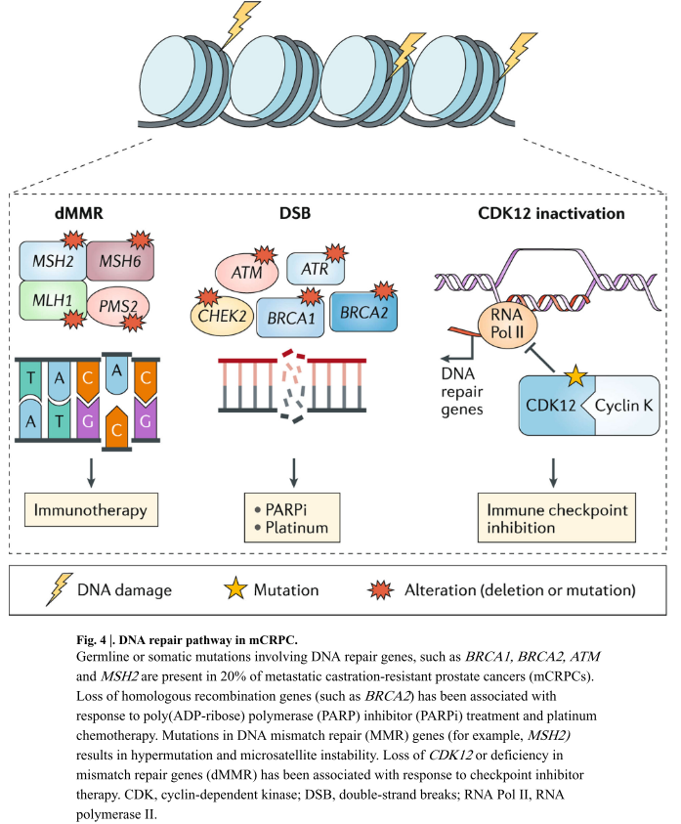
La vía de la reparación del DNA:
20% de afectación en HR en CPRCm.
3-5% de afectación en MMR en CPRCm.
Ku et al. Nat Rev Urol. 2019;16:645–54
Notes:
La vía de la reparación del DNA.
Se observan alteraciones de reparación del ADN en ~ 20% de mCRPC, más comúnmente mutaciones en genes de recombinación homóloga (HR) como BRCA2, BRCA1 y ATM23 (Figura 4). Es importante destacar que estas alteraciones pueden ocurrir tanto a nivel somático (tumor) como a nivel de la línea germinal23,58. Debido a la alta frecuencia de alteraciones de la línea germinal (hasta en un 12% de los hombres con cáncer de próstata avanzado, incluso en pacientes no seleccionados por edad o antecedentes familiares) 58, la Red Nacional Integral del Cáncer ahora recomienda la prueba de la línea germinal para todos los pacientes con cáncer de próstata metastásico59. . Esta alta frecuencia de mutaciones tiene implicaciones importantes no solo para los hombres con cáncer de próstata, sino también para los miembros de su familia, ya que tienen un mayor riesgo de desarrollar otros tipos de cáncer60.
Los tumores que pierden la vía de la HR son preferentemente sensibles a la inhibición de la poli (ADP-ribosa) polimerasa (PARP) o la administración de un agente que daña el ADN, como la quimioterapia con platino, a través de un mecanismo de letalidad sintética61. Los inhibidores de PARP y la quimioterapia con platino son eficaces en otros tipos de cáncer con aberraciones del gen HR62. En mCRPC, se han observado respuestas significativas al tratamiento con el inhibidor de PARP olaparib63 o quimioterapia con platino64-66 en pacientes con deficiencia de HR (somática o línea germinal). Por ejemplo, el 88% de los pacientes (14/16) que tenían defectos de FC en un ensayo de fase II de olaparib respondieron a la terapia63. En un comunicado de prensa (agosto de 2019) se informó que un ensayo clínico de fase III de olaparib versus ARPI en hombres con mCRPC y una mutación del gen HR que habían progresado en ARPI anterior (el ensayo PROfound) había alcanzado su criterio de valoración principal de SLP radiográfica en Pacientes con mCRPC con alteraciones genómicas BRCA1, BRCA2 o ATM. Aún no se han publicado los datos completos, pero es probable que las pruebas de estas aberraciones genéticas se vuelvan más frecuentes. Aunque no se han reportado datos de ensayos clínicos prospectivos para quimioterapias basadas en platino en pacientes con deficiencia de FC, se han reportado respuestas excepcionales65–67. Aún se necesitan datos sobre qué genes probar y qué alteraciones responden mejor a los inhibidores de PARP y la quimioterapia con platino. Además, se requiere una comprensión más profunda de la resistencia al tratamiento, así como una comprensión de cómo identificar entre los pacientes que desarrollan resistencia a aquellos que se beneficiarían de la terapia secuencial con platino después de un inhibidor de PARP o viceversa68. La resistencia a los inhibidores de PARP y la quimioterapia con platino no se superponen completamente, pero ambas pueden implicar mutaciones de reversión que hacen que los genes de reparación del ADN restauren su marco de lectura abierto normal e inviertan la sensibilidad a los agentes que dañan el ADN69,70.
Además de los genes HR, aproximadamente el 3-5% de los pacientes con cáncer de próstata tienen una deficiencia en los genes de reparación de errores de emparejamiento (dMMR) como MSH2, MSH6, PMS2 y MLH1, que típicamente conduce a hipermutación e inestabilidad de microsatélites (MSI) 71. Las mutaciones en los genes MMR también pueden ocurrir a nivel somático o de la línea germinal, y la pérdida de la expresión de la proteína reparadora de errores de apareamiento a menudo se detecta en tumores mediante inmunohistoquímica. La presencia de dMMR en tumores de próstata se ha asociado con un aumento de la expresión de neoantígenos y PD-L1, e infiltración inmunitaria, incluida la regulación positiva de genes asociados con el reclutamiento de células dendríticas, macrófagos y otras células mieloides y células T72. La identificación de pacientes con dMMR es importante porque este subconjunto de pacientes es potencialmente susceptible a la inmunoterapia con inhibidores de puntos de control; se han informado respuestas a la inhibición de puntos de control en otros tipos de tumores71, y el pembrolizumab, un anticuerpo anti-PD-1, está aprobado por la FDA para todos los dMMR y tipos de cáncer MSI, incluido el cáncer de próstata73. Sin embargo, las respuestas en el cáncer de próstata dMMR y MSI no son universales; En un estudio, solo 6 de 11 pacientes con CRPC con tumores MSI-high / dMMR que fueron tratados con terapia anti-PD-1 lograron una disminución de PSA de> 50% 71. Se necesitan más datos para comprender por qué algunos pacientes no responden y para determinar el ensayo óptimo para evaluar la pérdida de MMR y MSI en el cáncer de próstata. No obstante, la aprobación de pembrolizumab para esta población seleccionada por biomarcadores ha llevado a un aumento de las pruebas clínicas para identificar a los pacientes para este tratamiento.
Las mutaciones inactivadoras de la quinasa CDK12 dependiente de ciclina, que están presentes en hasta el 7% de los tumores de mCRPC, también se han asociado con la respuesta a inhibidores de puntos de control inmunitarios. La quinasa 12 dependiente de ciclina (CDK12) es un factor de transcripción que forma un complejo con la ciclina K para regular la expresión génica en la vía de reparación del ADN; la inactivación da como resultado duplicaciones focales en tándem, aumento de fusiones de genes y producción de neoantígenos74. Se han observado respuestas de PSA excepcionales (dos de cuatro pacientes) en hombres con mCRPC con mutaciones de CDK12 tratados con un inhibidor del punto de control inmune anti-PD-174, lo que sugiere que las mutaciones de CDK12 podrían ser un biomarcador potencial de respuesta a la inhibición del punto de control inmune. Se está llevando a cabo un ensayo clínico de fase II de ipilimumab y nivolumab para mCRPC con mutación de CDK12 () 75.

Slide 33
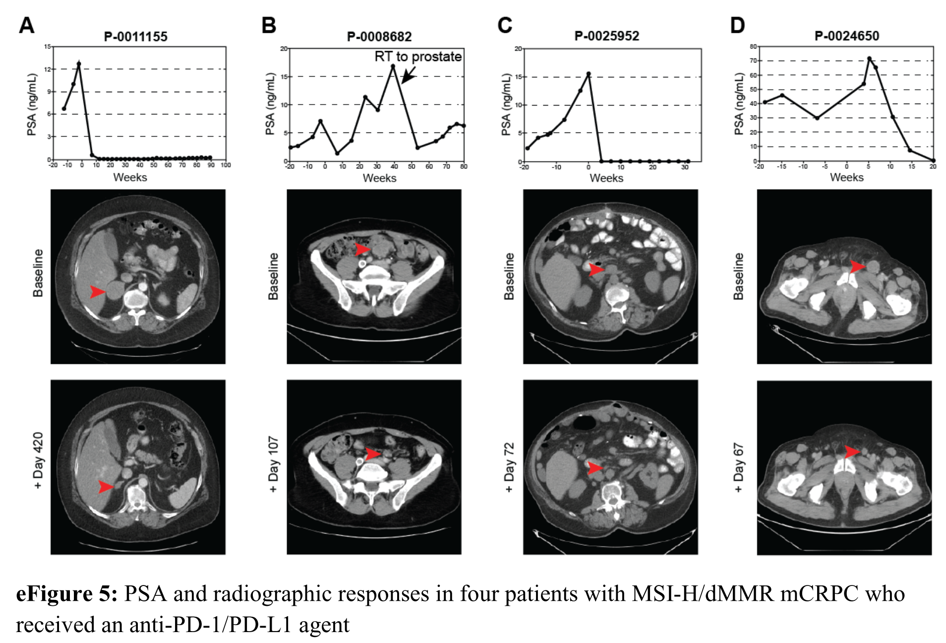
Abida et al. JAMA Oncol. 2019;5:471–8
Notes:
IMPORTANCE The anti–programmed cell death protein 1 (PD-1) antibody pembrolizumab is approved by the US Food and Drug Administration for the treatment of microsatellite instability–high (MSI-H) or mismatch repair–deficient (dMMR) solid tumors, but the prevalence of MSI-H/dMMR prostate cancer and the clinical utility of immune checkpoint blockade in this disease subset are unknown.
OBJECTIVE To define the prevalence of MSI-H/dMMR prostate cancer and the clinical benefit of anti–PD-1/programmed cell death 1 ligand 1 (PD-L1) therapy in this molecularly defined population.
DESIGN, SETTING, AND PARTICIPANTS In this case series, 1551 tumors from 1346 patients with prostate cancer undergoing treatment at Memorial Sloan Kettering Cancer Center were prospectively analyzed using a targeted sequencing assay from January 1, 2015, through January 31, 2018. Patients had a diagnosis of prostate cancer and consented to tumor molecular profiling when a tumor biopsy was planned or archival tissue was available. For each patient, clinical outcomes were reported, with follow-up until May 31, 2018.
MAIN OUTCOMES AND MEASURES Tumor mutation burden and MSIsensor score, a quantitative measure of MSI, were calculated. Mutational signature analysis and immunohistochemistry for MMR protein expression were performed in select cases.
RESULTS Among the 1033 patients who had adequate tumor quality for MSIsensor analysis (mean [SD] age, 65.6 [9.3] years), 32 (3.1%) had MSI-H/dMMR prostate cancer. Twenty-three of 1033 patients (2.2%) had tumors with high MSIsensor scores, and an additional 9 had indeterminate scores with evidence of dMMR. Seven of the 32 MSI-H/dMMR patients (21.9%) had a pathogenic germline mutation in a Lynch syndrome–associated gene. Six patients had more than 1 tumor analyzed, 2 of whom displayed an acquired MSI-H phenotype later in their disease course. Eleven patients with MSI-H/dMMR castration-resistant prostate cancer received anti–PD-1/PD-L1 therapy. Six of these (54.5%) had a greater than 50% decline in prostate-specific antigen levels, 4 of whom had radiographic responses. As of May 2018, 5 of the 6 responders (5 of 11 total [45.5%]) were still on therapy for as long as 89weeks.
CONCLUSIONS AND RELEVANCE The MSI-H/dMMR molecular phenotype is uncommon yet therapeutically meaningful in prostate cancer and can be somatically acquired during disease evolution. Given the potential for durable responses to anti–PD-1/PD-L1 therapy, these findings support the use of prospective tumor sequencing to screen all patients with advanced prostate cancer for MSI-H/dMMR. Because not all patients with the MSI-H/dMMR phenotype respond, further studies should explore mechanisms of resistance.

Slide 34
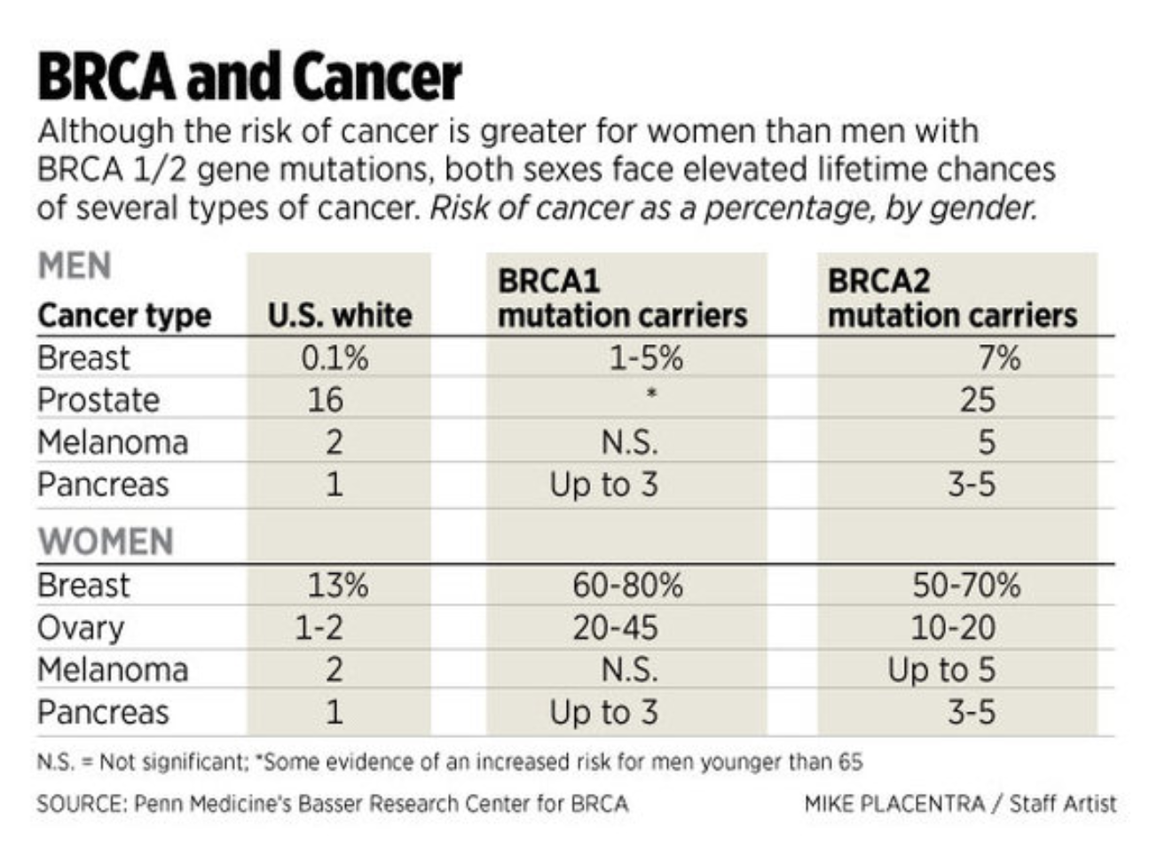
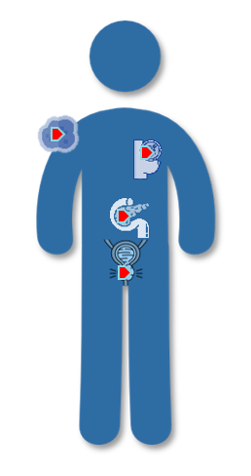
Y otros tumores además de próstata:
https://pinkhope.org.au/what-it-means-for-men-who-carry-a-brca-gene-fault/

Slide 35
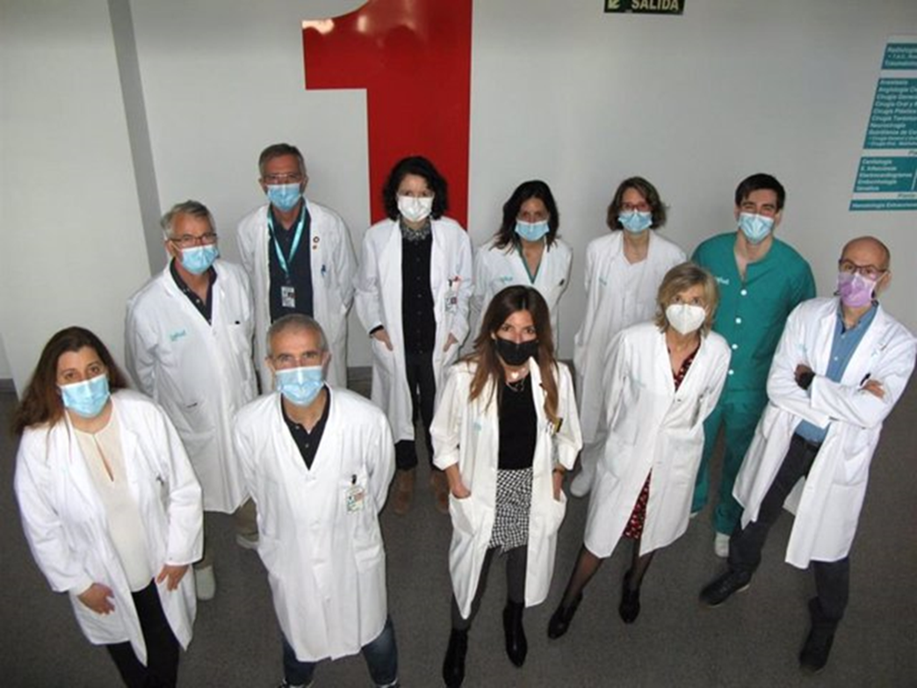
¿Cómo implementar todo esto?
Si quieres llegar rápido,
camina solo,
si quieres llegar lejos,
camina acompañado.
Proverbio africano
Σ Urología + Oncología Radioterápica + Genética + Oncología Médica + Anatomía Patológica
Grupo Interdisciplinar ‘ASGECAP’

Slide 36
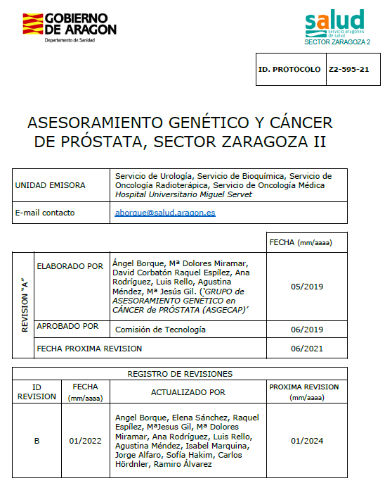
PROTOCOLO ASISTENCIAL
Inicio Grupo de Trabajo
2017
Confección de Protocolo de Asesoramiento Genético en Línea Germinal
2017 - 2018
Implementación Asistencial
2019
Revisión / Actualización
2022

Slide 37
¿A quién investigar? Protocolo ASGECAP-HUMS v3.2022
Varón diagnosticado de CaP, candidato a Asesoramiento genético vinculado a CaP:
Diagnóstico ≤ 60 años y/o GG ≥ 4
y/o, Con familiares con CaPH, Sínd. King y/o Sínd. Lynch
y/o, Candidatos a VA
y/o, CaP metastásico
y/o, Con panel genético en tumor (+)
y/o, Con diagnóstico CaP ductal, intraductal o patrón cribiforme
Familiares sin CaP, candidatos a Asesoramiento genético vinculado a CaP:
Diagnóstico de CaP ≤ 60 años en familiar de primer grado, con mutación identificada
y/o, Muerte por CaP ≤ 60 años en familiar de primer grado
y/o, Diagnóstico de CaP en 2 ó más familiares de segundo grado, con diagnóstico en al menos uno de ellos ≤ 60 años
y/o, Diagnóstico de Sínd. King o Sínd. Lynch en familiares de primer grado
Dr. Ángel Borque Fernando (ASGECAP-HUMS)

Slide 38
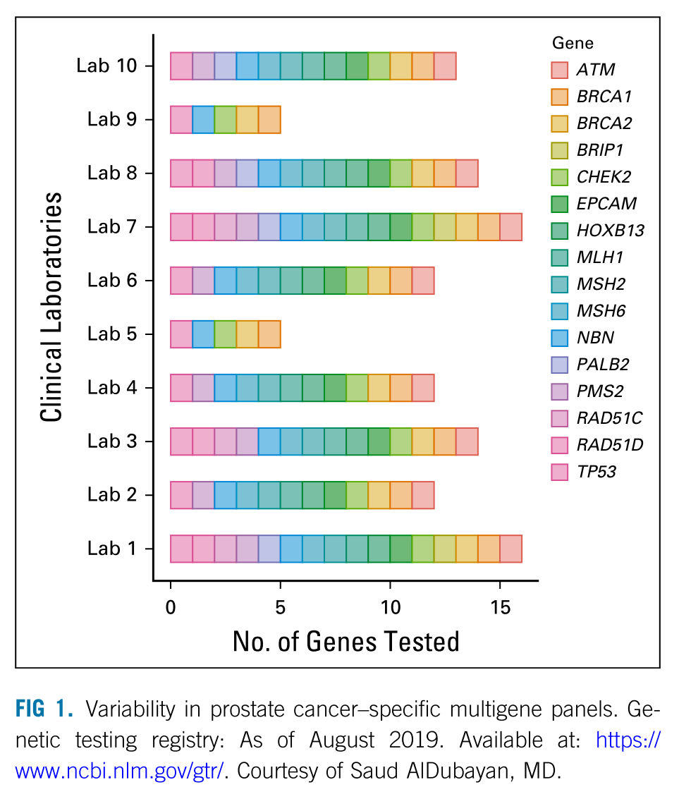
¿Qué genes investigar?
Protocolo ASGECAP-HUMS v3.2022
Exoma dirigido, panel 30 genes Próstata:
APC, ATM, ATR, BARD1, BRCA1, BRCA2, BRIP1, CDH1, CHEK2, EPCAM, FAM175A, FANCA, FANCD2, FANCM, GEN1, HOXB13, MRE11, MLH1, MSH2, MSH6, MUTYH, NBN, PALB2, PMS1, PMS2, PTEN, RAD51C, RAD51D, STK11, TP53
Exoma, panel 82 genes accionables ACMG:
ACTA2, ACTC1, ACVRL1, APC, APOB, ATP7B, BMPR1A, BRCA1, BRCA2, BTD, CACNA1S, CASQ2, COL3A1, DSC2, DSG2, DSP, DSP, ENG, FBN1, FLNC, GAA, GLA, HFE, HNF1A, KCNH2, KCNQ1, LDLR, LMNA, MAX, MEN1, MLH1, MSH2, MSH6, MUTYH, MYBPC3, MYH11, MYH7, MYH7, MYL2, MYL3, NF2, OTC, PALB2, PCSK9, PKP2, PMS2, PRKAG2, PTEN, RB1, RET, RET, RET, RPE65, RYR1, RYR2, SCN5A, SCN5A, SCN5A, SDHAF2, SDHB, SDHC, SDHD, SMAD3, SMAD4, SMAD4, STK11, TGFBR1, TGFBR2, TMEM127, TMEM43, TNNI3, TNNT2, TNNT2, TP53, TPM1, TRDN, TRDN, TSC1, TSC2, TTN, VHL, WT1
ACMG: American College of Medical Genetics and Genomics
Giri VN. Consenso Philapelphia-2019. JCO 2020;38:2798-811
Miller DT. Genet Med 2021;23:1381–90
Dr. Ángel Borque Fernando (ASGECAP-HUMS)

Slide 39
¿Cómo informar? Protocolo ASGECAP-HUMS v3.2022
Varón diagnosticado de CaP , candidato a Asesoramiento genético vinculado a CaP :
- Decisión individualizada: VA, CPRCm, …
- Recomendación de estudio familiar, si hallazgo (+)
Familiares sin CaP, candidatos a Asesoramiento genético vinculado a CaP:
- Iniciar estudio a los 40 años, o 5 años antes del diagnóstico en el familiar afecto
Umbrales de PSA sugeridos para la toma de decisiones en portadores de mutaciones, sobretodo ante línea germinal BRCA1 y BRCA2, y en general ante sospecha de CaP Hereditario
Los umbrales de PSA sugeridos corresponden al límite alto de normalidad ajustado a edad referido en diferentes series. | Edad
 | < 49 años | 50-59 años | 60 – 69 años
Seguimiento anual (PSA y T.R.) | < 0,75 | < 1,0 | < 1,5
Remitir a Urología, para valorar: biomarcadores, resonancia magnética y en su caso Bx. | ≥ 0,75 | ≥ 1,0 | ≥ 1,5
Modificado de Cheng HH. Clin Genitourin Cancer 2017; 15: 625–8
Dr. Ángel Borque Fernando (ASGECAP-HUMS)

Slide 40
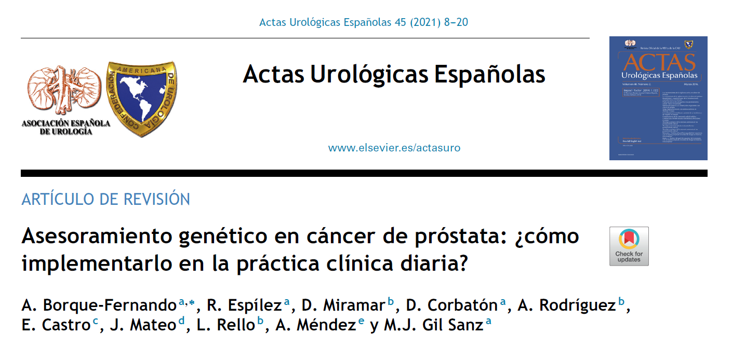
Dr. Ángel Borque Fernando (ASGECAP-HUMS)
https://doi.org/10.1016/j.acuro.2020.08.009

Slide 41
CaP Avanzado (CPRC-CPHSm)
Consultas periféricas
Proceso de Cáncer de Próstata
Vigilancia Activa
Oncología Radioterápica
Oncología Médica
Asesoramiento genético
Genética
Dr. Ángel Borque Fernando (ASGECAP-HUMS)

Slide 42
Mis conclusiones, a 10/06/2023 6:57:
Empezamos a conocer la implicación del riesgo genético en el cribado del cáncer de próstata, y ¿cómo implementarlo en práctica clínica?
Es innegable el peor pronóstico en cáncer de próstata localizado y metastásico (g/sBRCA2, fundamentalmente).
Las mutaciones en recombinación homóloga (g/sBRCA1/2) suponen una muy interesante alternativa terapéutica en CPRCm (iPARP en 2ª y 1ª línea).
No olvidemos otros tumores y la afectación familiar ligadas a un síndrome de cáncer hereditario.
Dr. Ángel Borque Fernando (ASGECAP-HUMS)

Slide 43
Dr. Ángel Borque Fernando (ASGECAP-HUMS)

Slide 44
together
Grupo
ASGECAP - HUMS
Working
asgecap@gmail.com

